Slide 1
Air Masses and Fronts
7.E1.3

Slide 2
Essential Question
Why does the Earth experience weather?
There are 2 reasons:
The movement of air masses;
The movement of fronts.

Slide 3
Air Masses
https://www.youtube.com/watch?v=tkK4_F0VKhM
Definition: A large dome of air which has similar temperature and moisture characteristics throughout.

Slide 4
World Map
Where would you expect to find cold air masses? Warm air masses?

Slide 5
North America Where would you expect to find cold air masses? Warm air masses?

Slide 6
Air Mass Animation
http://www.classzone.com/books/earth_science/terc/content/visualizations/es2001/es2001page01.cfm?chapter_no=visualization
All around the earth, large masses of air move around and constantly change the weather.
They are named based on where they are coming FROM.

Slide 7
Types of air masses affecting the weather of the U.S.
1. Continental polar (cP)
Cold, dry, and stable
Originates in Canada and influences Northern U.S.
Responsible for clear, pleasant weather during the summer
Responsible for lake effects snow around the Great Lakes in winter

Slide 8
Types of air masses affecting the weather of the U.S.
Maritime polar (mP)
Cool, unstable, and moist
Originates over icy waters of the northern Atlantic and Pacific Oceans and mainly influences Pacific Northwest and Northeast

Slide 9
Types of air masses affecting the weather of the U.S.
Continental Tropical
Warm, stable, and dry
Originates over Mexico and affects the Midwest
Responsible for hot dry summers and warm dry winters

Slide 10
Types of air masses affecting the weather of the U.S.
4. Maritime Tropical
Warm, unstable, and moist
Originates over southern Atlantic and Pacific Oceans and mainly influences Pacific Southwest, Midwest, Northeast, and Southeast

Slide 11
What type of weather would the following air masses bring?

Slide 12
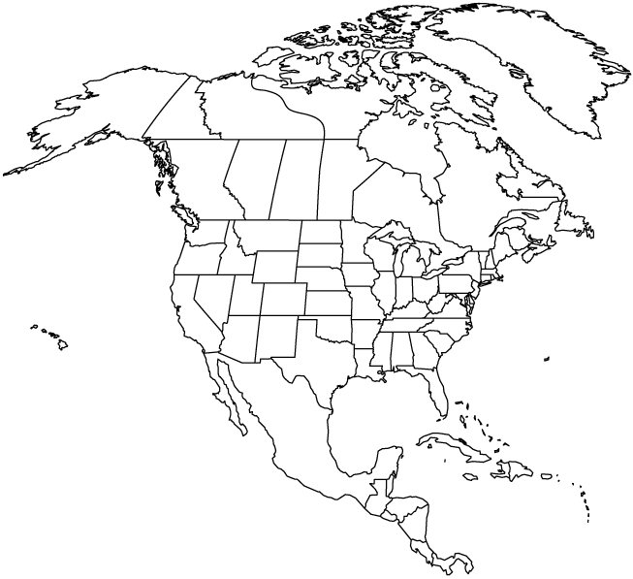
Lab: Diagram and label each air mass affecting the U.S. Color code your diagram.

Slide 13
Fronts
The Earth has 4 major air masses, two warm ones and two cold ones. When those air masses run into each other, the place where they meet is called a front.
Fronts are responsible for all kinds of weather like snow and storms.
Study Jams air masses and fronts

Slide 14
Fronts
A boundary created when two air masses meet.
Fronts are named for the air mass that is moving.

Slide 15
Fronts Demonstration
Materials: water bottle, ice water, oil, and red and blue food coloring
Your teacher will pour the red colored oil and the blue colored ice water into the bottle. I will need a volunteer to come and shake the bottle. Make an observation of the bottle after it is shaken.
Wait a few minutes, and make another observation: what happened to the oil and water inside the bottle?

Slide 16
Fronts activity
The water and oil represent air. Knowing this, explain how you think air behaves when air of different temperatures meet.
Write your answer in complete sentences.
Using the color pencils, draw what you made and label.
This is a qualitative observation.

Slide 17
In the activity that we just did…
Where is the “front”?

Slide 18
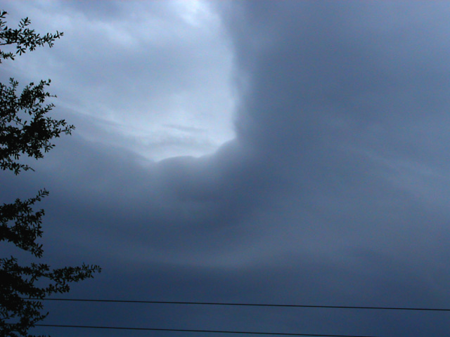

Slide 19
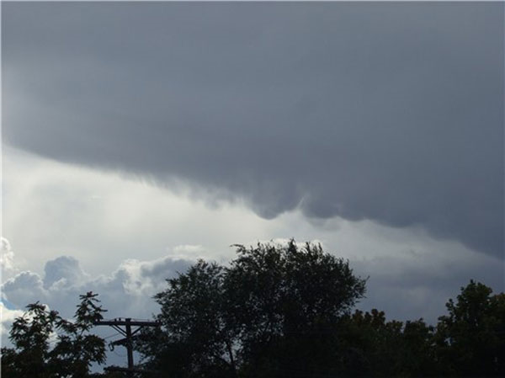

Slide 20
Fronts animation
http://www.classzone.com/books/earth_science/terc/content/visualizations/es2002/es2002page01.cfm?chapter_no=visualization

Slide 21
Fill in the “Weather Fronts” chart as you follow along the next few slides.

Slide 22
Cold Front
Cold dense air moves in and pushes warm air out of the way
Cold fronts move very quickly and bring short periods of rain/thunderstorms
Lower temperatures are behind the front
SYMBOL – the direction of the “arrows” points towards the direction the front is MOVING

Slide 23
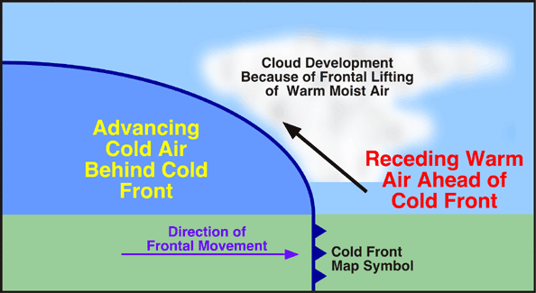

Slide 24
A cold front

Slide 25
Warm Front
Warm air moves up the cold front as it slowly displaces and overtakes the cold air
Warm fronts move slowly, and bring many days of steady precipitation
Higher temperatures are behind the front
SYMBOL – direction of “half-moons” is the direction the front is moving

Slide 26
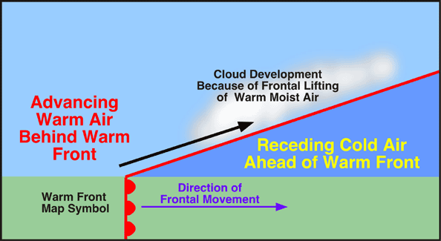

Slide 27
Warm front

Slide 28
Animations
http://www.classzone.com/books/earth_science/terc/content/visualizations/es2002/es2002page01.cfm?chapter_no=visualization
Cold front
Links to cold front videos

Slide 29
Stationary front
Created when cold and warm masses meet but neither one has enough force to move the other out of the way.
The water vapor in the warm air condenses into rain, fog, snow, clouds.
Can bring many days of precipitation

Slide 30
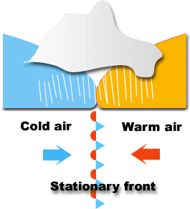

Slide 31
Links
Stationary front videos

Slide 32
Occluded front
Is created when a warm air mass is caught between two cooler air masses.
The two denser cooler air masses cut off the warm air mass from the ground.
As the warm air mass cools, it may turn cloudy, rainy or snowy.

Slide 33
Watch video clip of a weather report.
http://www.youtube.com/watch?v=HQrB37YQo9Y start at 2:10
http://www.youtube.com/watch?v=OdcCMn5sbzM&feature=related start at 1:30
http://www.youtube.com/watch?v=nS1nwfRUaaU&feature=related start at :30

Slide 34
Do a weather report

Slide 35
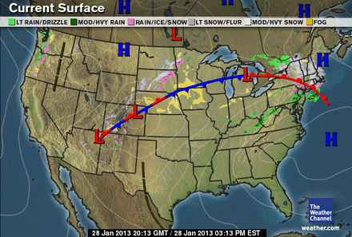

Slide 36
Summarize
Why does the Earth experience weather?
Write an introductory paragraph, a paragraph explaining air masses and how they affect Earth’s weather, a paragraph explaining fronts and how they affect Earth’s weather, and a closing paragraph.

