Slide 1

You will be using both your graphic organizer and your guided notes today

Slide 2
AIR POLLUTION:
MOST COMES FROM HUMANS BURNING FOSSIL FUELS FOR ENERGY
(Fossil fuel = coal used in factories and gas used in cars!)

Slide 3
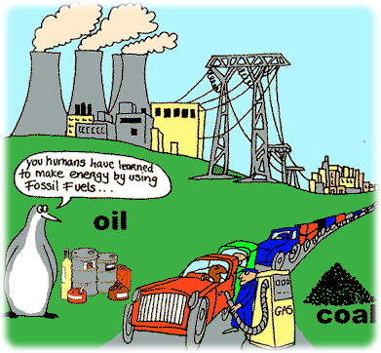
FOSSIL FUELS:
Made from the remains of prehistoric animals and plants
Add too much carbon dioxide to the air!
The most potent way humans contribute to global warming!
EXAMPLES: coal, petroleum, natural gas (the kind used to heat your home!)

Slide 4
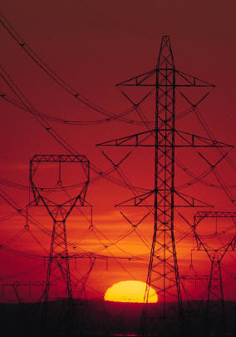
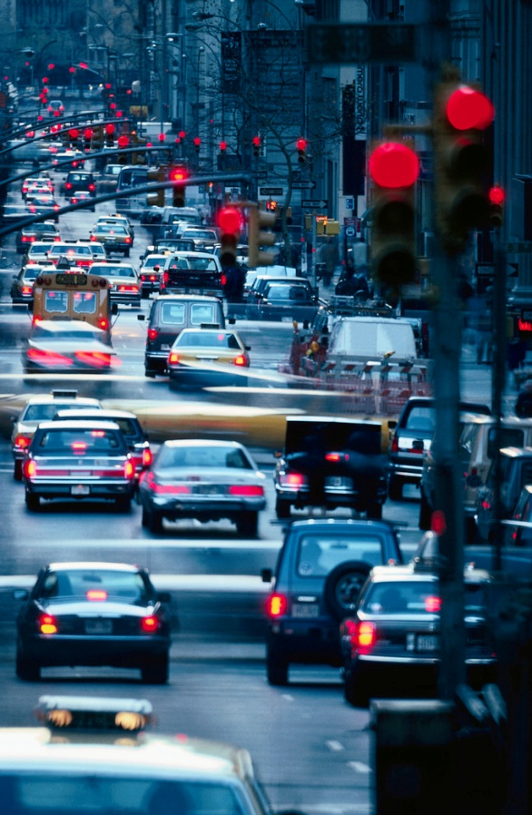
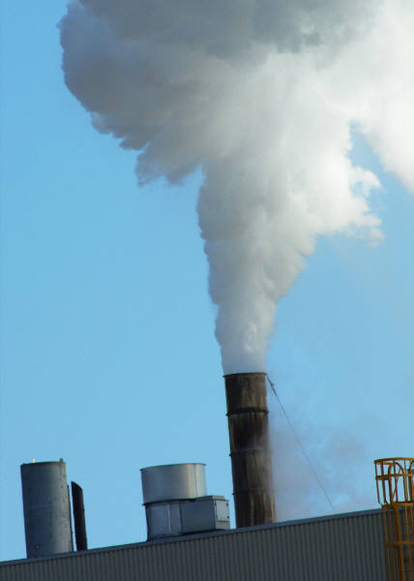
HUMANS BURN FOSSIL FUELS FOR ENERGY
Pollution from coal, natural gas, and oil
Pollution from coal, natural gas, and oil
Pollution from coal, natural gas, and oil

Slide 5
Fossil Fuels Think/Pair/Share
(Teacher Check)
Think Pair Share (teacher check)→
How do humans contribute most to global warming?
Think Pair Share (Teacher Check→
What are 3 ways that we use fossil fuel?

Slide 6
Greenhouse Gases:
gases that trap heat in the atmosphere

Slide 7
Greenhouse Gases:
gases that trap heat in the atmosphere
Ozone
(O₃)
Methane
(CH₄)
Carbon Dioxide
(CO₂)

Slide 8
Global Warming: An Overview
Global Warming
the idea that the Earth is getting warmer because of humans releasing too many greenhouse gases into the atmosphere

Slide 9

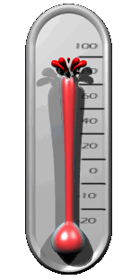



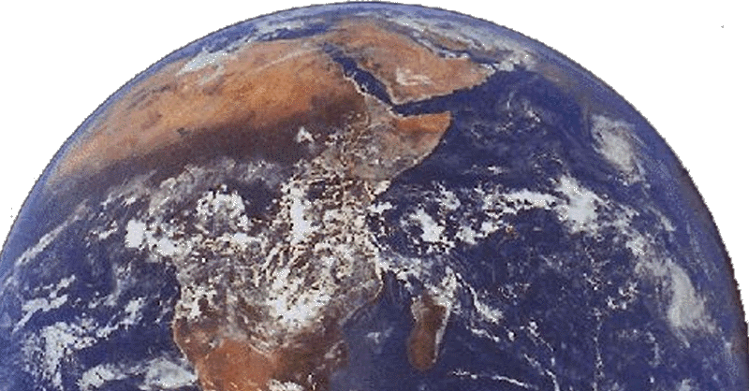



How Global Warming Works
Carbon Dioxide (CO₂)
Fossil fuels (coal, oil, natural gas)

Slide 10
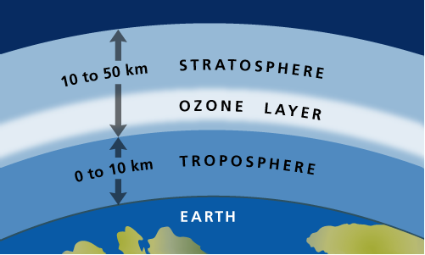

Wait…..Huh?
Good Ozone = Ozone in the stratosphere
(Protects us from harmful radiation!!!)

Slide 11

Without Ozone in the stratosphere…

Slide 12






Bad Ozone = Ozone in the troposphere
(Ozone in the Troposphere is a greenhouse gas!!!)

Slide 13
Particulate Matter:
Tiny particles (solid or liquid) mixed in with the air

Slide 14
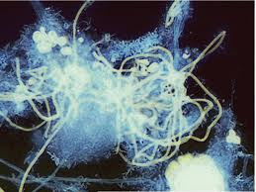
What does this look like to you?

Slide 15
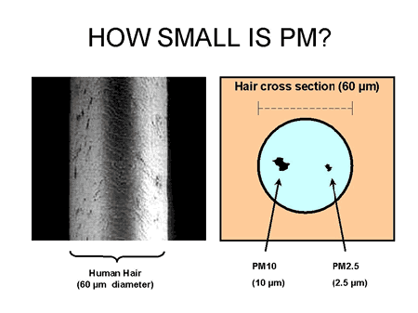
It’s Particulate Matter under a very powerful microscope!!!!!!

Slide 16
Particulate Matter:
Tiny particles (solid or liquid) mixed in with the air
Dust
Dirt
Pollen

Slide 17
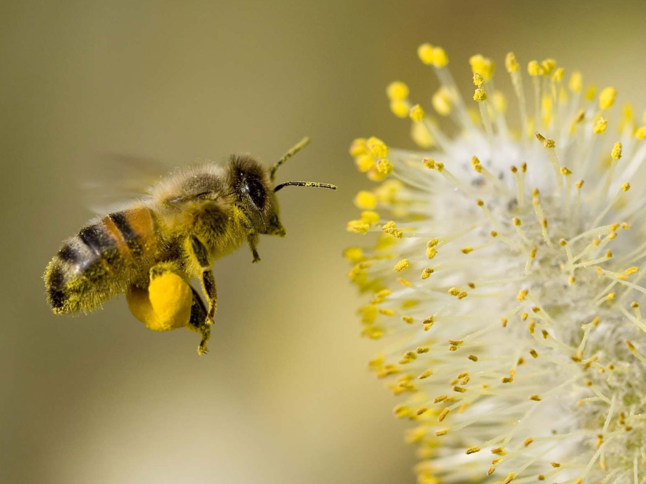
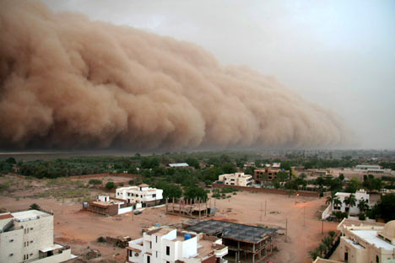
PARTICULATE MATTER
Tiny particles or droplets that are mixed in with air.
EXAMPLES: dust, car exhaust, pollen
That’s DUST!

Slide 18
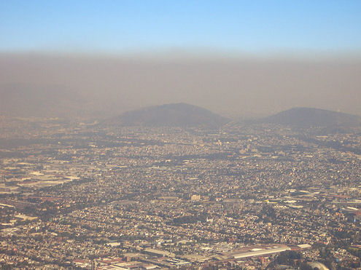
Mexico City, Mexico

Slide 19
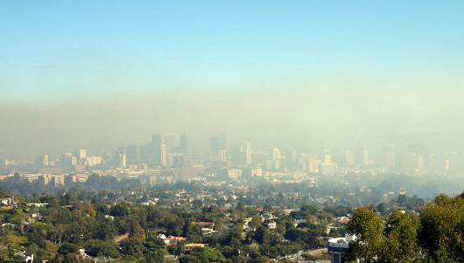
Los Angeles, California

Slide 20
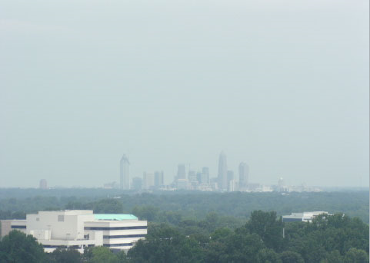
Charlotte, NC

Slide 21
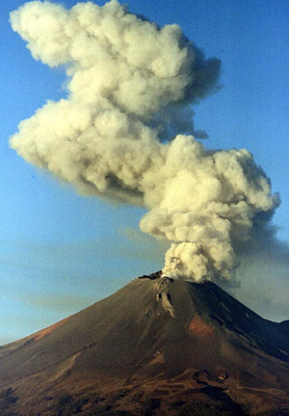
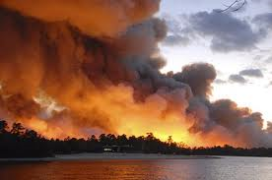
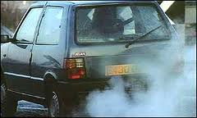
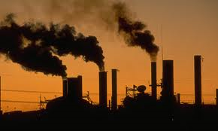

Slide 22
Particulate Matter Think/Pair/Share
Share with a partner→
What IS particulate matter?
Share with another partner→
What is an example of particulate matter?

Slide 23
Air Quality- what is it and how do we define “good”
Lets Break it down. Who knows what the word quality means?
Who Knows What Air is?
So who can figure our what air quality is?

Slide 24
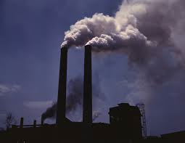
WHO is the EPA? What do they track?
Air Quality- determines the amount of pollution and particulate matter in the air
Environmental Protection Agency- tracks and reports air quality

Slide 25
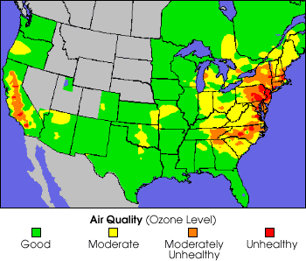
Air Quality Index Maps
There are 4 colors that indicate the quality of air.
Green | Low Particulate concentration, Air Quality is good
Yellow | Some Particulate concentration, Air Quality is O.K.
Orange | Moderately unhealthy concentration of particulate matter, Air Quality is not good
Red | High Particulate concentration, very unhealthy Air Quality.

Slide 26

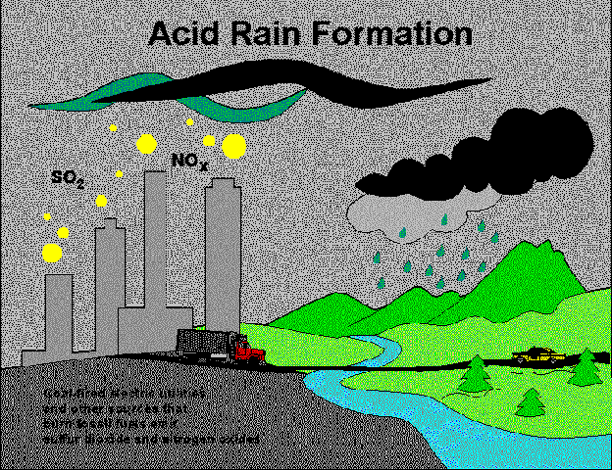
Acid Rain
Rain that has become much more acidic due to pollution; sulfur dioxide and nitrogen oxide
Caused by factories, power plants, automobiles
Acid rain harms trees and pollutes lakes

Slide 27

Flower Activity
1. Complete the Flower Activity handout. Please answer the questions using complete sentences.
2. Each question should be answered in a petal of the flower ☺

Slide 28

Global Pollution Issues Questions
Please answer the questions provided
Use complete sentences
These will be due tomorrow!!

Slide 29
Exit Ticket
You wake up Saturday morning and it is a beautiful day. You go for a walk and notice clear skies. Describe the air quality at this time. As you continue to walk, you notice a ton of cars driving, a factory let out smoke, and also a lot of wind. Describe the change in air quality.

