Slide 1
Today’s LEQ: What forces act on Lebron James when he makes a dunk?
Stop & Jot
Notes:
http://www.youtube.com/watch?v=mpNdR42opXc

Slide 2
What is a Force?
Force
pull
push

Slide 3
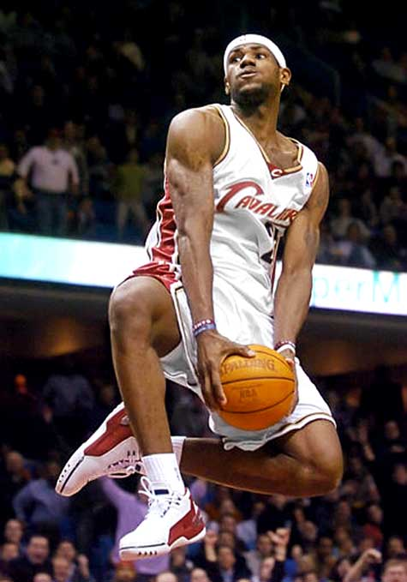
What forces do you see in this picture?

Slide 4
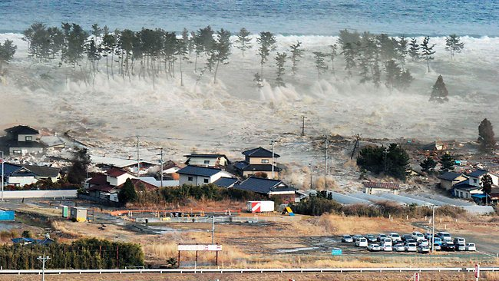
Tsunami, Japan 2011
What forces do you see in this picture?

Slide 5
BALANCED FORCE: forces that do not change the direction of the object

Slide 6
BALANCED FORCE:
(DOES NOT MOVE)

Slide 7
UNBALANCED FORCE: forces that DO change the direction of an object

Slide 8
UNBALANCED FORCE:
(DOES MOVE)

Slide 9
The Human Force Experiment!
What happens when one person applies more force than the other?
What needs to happen in order for you to both be able to stand up?
What happens when you and your partner apply unbalanced forces to each other?
What happens when you and your partner apply balanced forces to each other?

Slide 10
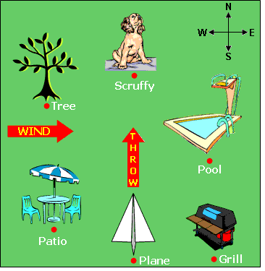
EOG Preparation
A diagram of Ashley's backyard is shown below. If she aims her throw directly at Scruffy, where is the paper airplane most likely to end up?
Why? (Use the word force.)

Slide 11
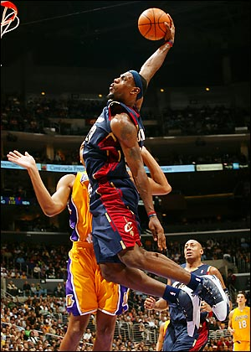
Exit Ticket: (4 minutes)
How can we see the different forces when Lebron James goes up for a dunk? Use balanced & unbalanced forces in your answer.

