Slide 1
Forms of energy
October 2014

Slide 2
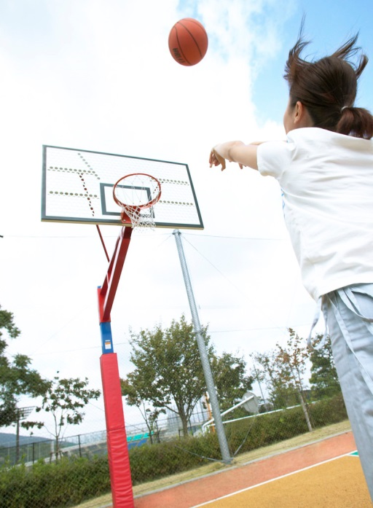
Energy defined
Energy is the ability of a person or an object to do work or to cause a change.
You can think of work as a transfer of energy.

Slide 3
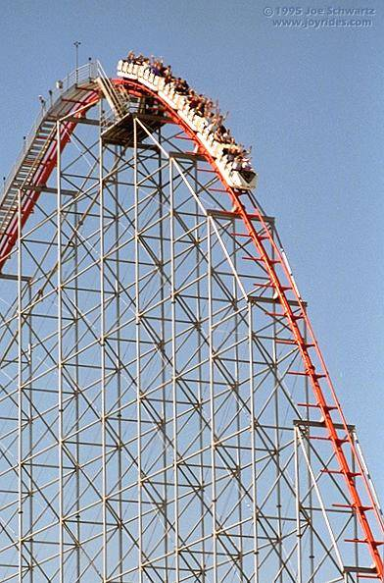
Kinetic energy
Energy of motion; any moving object has kinetic energy.
Examples:
Roller coaster car traveling
down hill.
Throwing a ball
Jumping on a trampoline

Slide 4
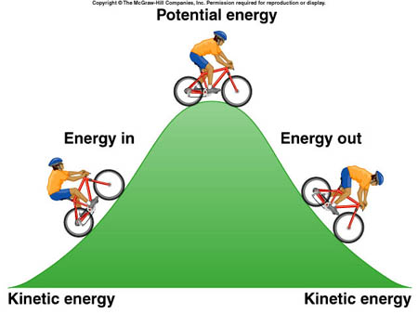
Potential energy
Stored energy; energy an object has due to its position or its shape.
Examples:
Rollercoaster car on
top of hill
Rubber band stretched
out before flicked.
Bow and arrow

Slide 5
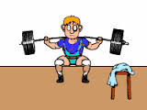
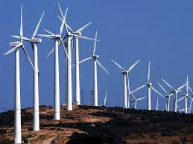
Mechanical energy
Energy possessed by an object due to its motion or position; object’s combined potential and kinetic energy.
Examples:
A thrown baseball
Windmills
Weightlifting

Slide 6
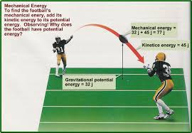
Law of conservation of energy
Total amount of energy never changes; no matter how energy is transferred or transformed, all of the energy is still present somewhere in one form or another.

