Slide 1
Weather Unit
Today you will be working on Page (21):

Slide 2
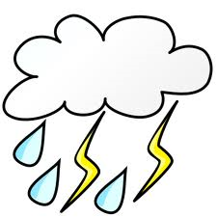
Types of Weather
HIGH PRESSURE SYSTEM
LOW PRESSURE SYSTEM
H
L
SYMBOL
WEATHER
PICTURE
Clear skies and fair weather
Cloudy, rainy, and stormy weather

Slide 3
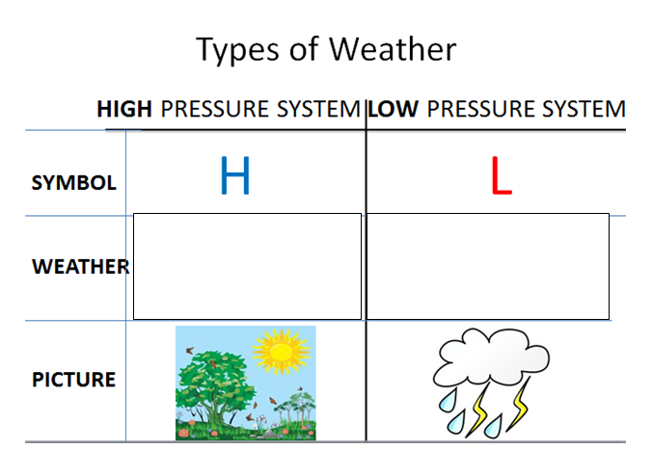
DON’T BE FRONT’N!!!!
Copy the definition under your Types of Weather chart
A Weather front is a boundary between TWO DIFFERENT AIR MASSES
Should look like this
Don’t Be Front’N
A Weather front is a boundary between TWO DIFFERENT AIR MASSES

Slide 4
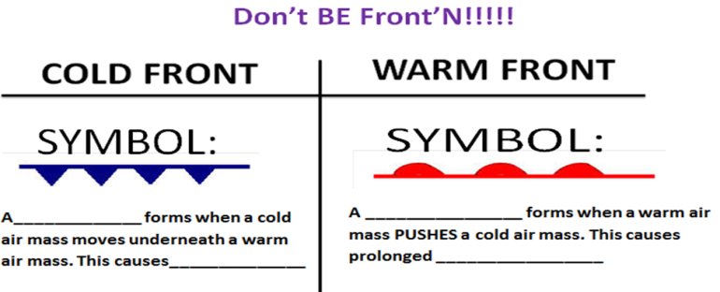
DON’T BE FRONT’N!!!!
Fill in the Cold and Warm Air front chart
Should look like this
Don’t Be Front’N
A Weather front is a boundary between TWO DIFFERENT AIR MASSES

Slide 5
COLD FRONT
SYMBOL:
WARM AIR
COLD AIR
A COLD FRONT forms when a cold air mass moves underneath a warm air mass. This causes violent storms

Slide 6
WARM FRONT
SYMBOL:
WARM AIR
COLD AIR
A WARM FRONT forms when a warm air mass PUSHES a cold air mass. This causes PROLONGED RAIN AND FOG.

Slide 7
Pulse Check Review Top half of page (23)
Copy down the following
Pulse Check Review
What would you predict the weather to be in…
Las Vegas, NV:
Charlotte, NC:
Chicago, IL:
Use the map on the next slide to complete your pulse check
When you have completed your Pulse Check: Raise your hand for me to check your work

Slide 8
Pulse Check Review TOP HALF OF PAGE 23
Using the map on the next slide complete your Pulse Check
Pulse Check Review
What would you predict the weather to be in…
Las Vegas, NV:
Charlotte, NC:
Chicago, IL:
Should look like this
When you have completed your Pulse Check: Raise your hand for me to check your work

Slide 9
What would you predict the weather to be in….
Reminder: Fronts move in the direction they are pointing.
CHICAGO
LAS VEGAS
Charlotte
Reminder: Fronts move in the direction they are pointing.

Slide 10
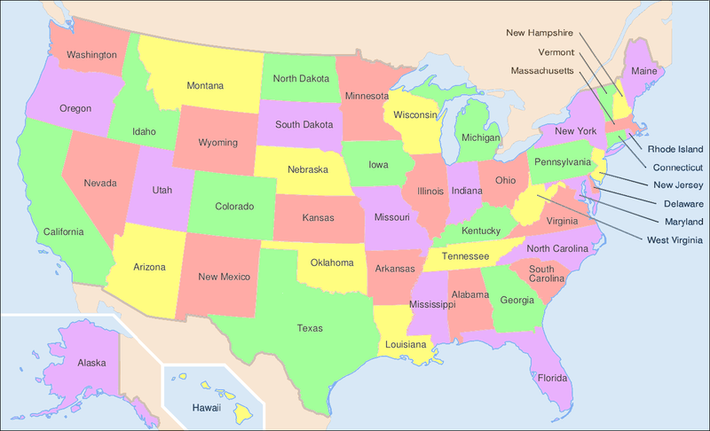
Independent Practice
MAKE YOUR OWN WEATHER REPORT!!!
MUST INCLUDE
AT LEAST ONE…..
HIGH PRESSURE SYSTEM
LOW PRESSURE SYSTEM
WARM FRONT
COLD FRONT
Use the symbols we learned today to draw at least one of each of these things on your map. Below (or next to) your map write a weather report to explain the type of weather happening at each symbol on your map.
EXAMPLE:
There is a low pressure system over Wyoming, which will cause rain and thunderstorms.
L

