Slide 1
Hierarchical organization
Mettler 2016

Slide 2
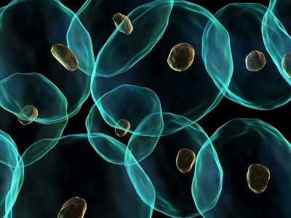
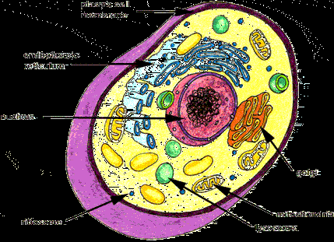
Cells
Cells are the smallest living part of your body.
Cells make up all living things. Some living things are only one cell (Amoeba, paramecium, Euglena, volvox).
In humans, we have specialized cells, meaning they perform certain jobs: example, red blood cells carries oxygen from our lungs to all parts of our body.

Slide 3
Tissues
A group of similar cells that work together to perform a particular function.
Four types of tissues:
Epithelial: covers inner and outer surfaces of your body. Includes skin and lining of our organs
Nerve: messaging system between brain and parts of body
Muscle: movement; throwing a ball is voluntary movement; your stomach digesting a meal is involuntary (no control) your heart beating is another example
Connective tissue: holds parts of the body together; provides support, protection, strength, padding, and insulation. Includes tendons and ligaments that hold our bones together. Bone is also a connective tissue- it supports and protects the soft parts of your body,

Slide 4
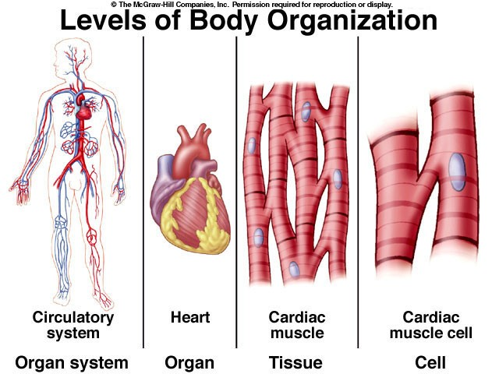
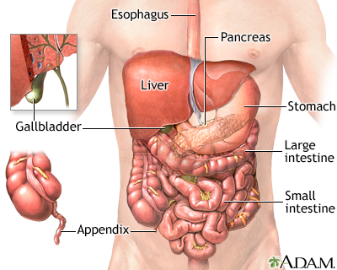
Organs
An organ is a group of tissues that work together to carry out a function in the body.
An organ’s structure relates to its function: the heart is muscular, allowing it to function as a pump; likewise, the stomach is bag shaped with strong muscular walls to help it digest our food

Slide 5
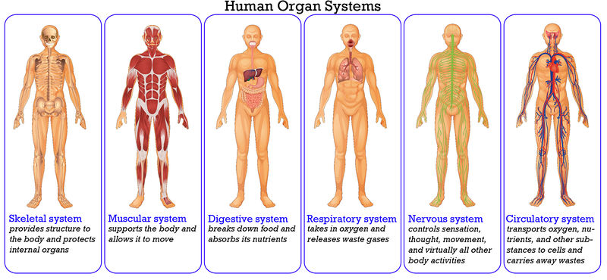
Organ System
Group of organs that work together to perform a function that helps the body meet its needs for energy and materials.
These systems include skeletal, muscular, respiratory, circulatory, digestive, nervous, endocrine, urinary, immune, and reproductive.
Important:
Homeostasis: the ability of your body to maintain internal conditions; temperature, amount of sugar in blood, even your posture.

