Slide 1
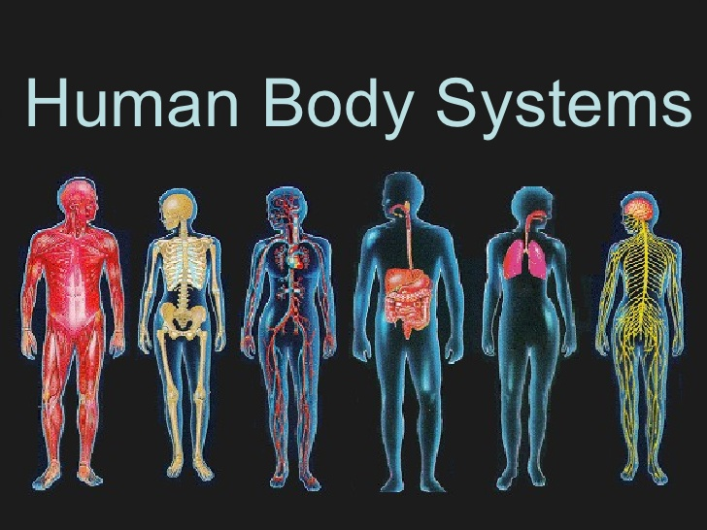

Slide 2
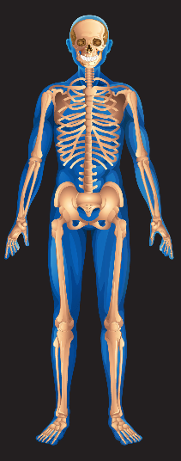
Skeletal System

Slide 3
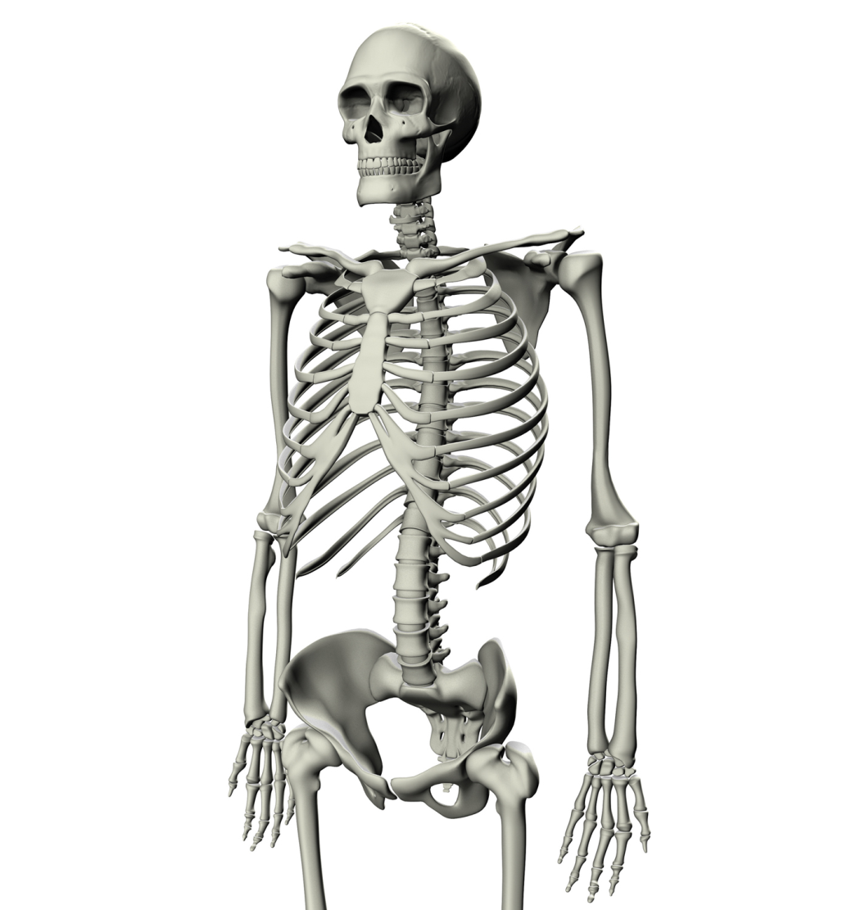
Skeletal System
What is the purpose?
Assists your body with support, protection and movement

Slide 4
Skeletal System
What are the parts and their purpose?
Support
The bones of your skeleton keep us from being a jello-like blob
Protection
Rib cage protects the heart and lungs
Skull protects the brain
Spine protects the spinal column

Slide 5
Skeletal System
Movement
Bones connect to one another at our joints
Ex: elbow, wrist, neck, ankle…
Bones depend on working with the muscles in order to move; one cannot move without the other!
Muscles are connected to bones by tissues called tendons
***Bones are connected to other bones by tissues called ligaments

Slide 6
Skeletal System
What can go wrong?
Osteoporosis: bones loose calcium and become brittle; common among older women
Arthritis: attacks joints and the surrounding tissue causing swelling and pain with movement.

Slide 7
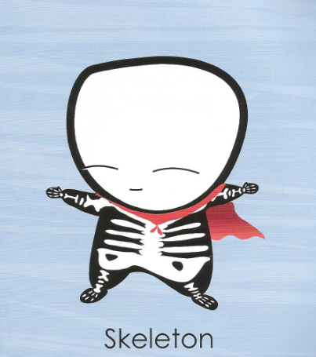
Skeletal System
Fun Facts:
A super group of 206 bones
These upright guys provide a framework for your body
The longest bones are in your legs; the smallest are in your ears
Total weight of the skeleton: 20 lbs.
Person with the most broken bones: Evel Knievel (35 fractures)
Number of bines in spine: 26

Slide 8
Skeletal System
How does it work with other body systems?
Muscular system: muscles are connected to bones which allow them to move
Circulatory system: inside of your bone marrow is where red blood cells are made

Slide 9
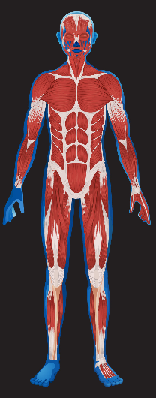
Muscular System

Slide 10
Muscular System
What is the purpose?
Works with the skeletal system to allow movement
Each muscle is made up of individual muscle fibers; each fiber is one long, stretchy cell
Move by a series of contractions (tightening) and releases
Muscles work in pairs
Muscles connect to bones by tissues called tendons

Slide 11
Muscular System
What are the parts and their purpose?
Voluntary muscles: you have control
Involuntary muscles: they move automatically
Three types
Skeletal: voluntary muscles connected to your bones
Cardiac: involuntary muscle, found in your heart
Smooth: involuntary muscle, found in your digestive system

Slide 12
Muscular System
What can go wrong?
Muscular dystrophy: causes weakness and loss of muscle mass
Fibromyalgia: syndrome in which a person has long term, body wide pain and tenderness in the joints, muscles, tendons, and other soft tissues
Sprain: stretching or tearing of a ligament (tissues that hold bones together); the most common muscle disorder

Slide 13
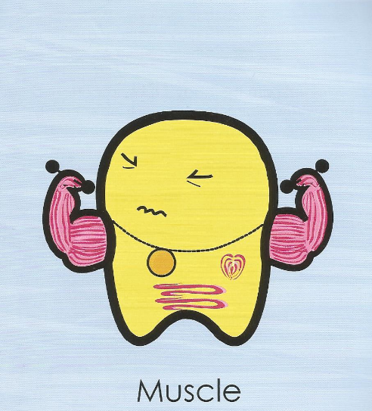
Muscular System
The muscleman who keeps you on the move
A bundle of protein filaments that shorten when electrified
Meat is the muscle of animals such as cows and chickens
Largest muscle: gluteus maximus (buttocks)
Number of muscles needed to smile: 12
Number of muscles needed to frown: 11

Slide 14
Muscular System
How does it work with other body systems?
Skeletal system: muscle connects to bones to help it move
Nervous system: nerves tell your muscles how and when to move
Circulatory system: blood vessels go throughout your muscles to help give them nutrients/oxygen and take away waste; makes up your heart
Digestive system: muscles line your digestive tract

Slide 15
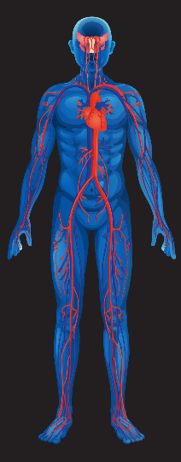
Circulatory System

Slide 16
Circulatory System
What is the purpose?
To carry oxygen rich blood around the body and deliver it to the muscles and organs
To carry nutrients around the body and deliver it to the muscles and organs
To pick up waste from muscles and organs and deliver it to the lungs or kidneys for excretion

Slide 17
Circulatory System
What are the parts and their purpose?
Heart
A muscle that pumps blood throughout your body
Made of cardiac muscle
Located in the center of your chest between your lungs
Protected by your sternum and rib cage
Blood vessels
Tubes that carry blood around your body
The three types are arteries, capillaries, and veins

Slide 18
Circulatory System
What are the parts and their purpose?
Arteries
Carry blood away from the heart
Blood is full of oxygen
Capillaries
Very tiny blood vessels
Found in the organs and muscles
Where oxygen is dropped off and waste is picked up
Walls of these tubes are so thin that oxygen can pass right through
Veins
Carry blood towards the heart
Blood is full of carbon dioxide

Slide 19
Circulatory System
What can go wrong?
Myocardial infarction: blood vessels that go around the heart get blocked; heart muscle tissue dies; heart attack results
Atherosclerosis: high fat diet results in arteries becoming hard; higher blood pressure results; heart and kidney damage can follow
Endocarditis: inner lining of heart swells/becomes inflamed; some antibiotics can treat

Slide 20
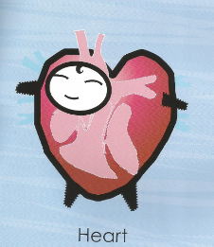
Circulatory System
A fist-sized organ that pumps blood around your body
The tireless muscleman sits just to the left in your chest
When this guy gets sick, the rest of the body can’t keep going
Adult heart rate: 75 beats per minute
Blood pumped in one year: 793,000 gallons
Number of heartbeats in a lifetime: 1 to 3 billion

Slide 21
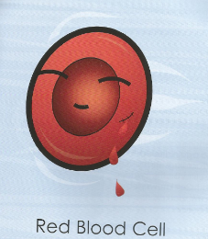
Circulatory System
Live-fast-die-young hero who gives blood its red color
A round cell with no nucleus, but fill of iron
Busy fellow who carries oxygen around the body
Average life span: four months

Slide 22
Circulatory System
How does it work with other body systems?
Respiratory system: blood passes through the lungs in order to pick up fresh oxygen or drop off carbon dioxide
Muscular system: arteries carry oxygen and nutrients to the muscles; veins carry carbon dioxide and other waste away from the muscles
Skeletal system: red blood cells are made in bone marrow, which can be found inside bones
Urinary system: blood vessels run through the kidneys so they can be filtered of waste material

Slide 23
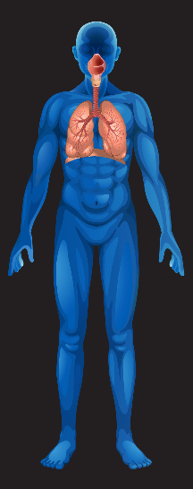
Respiratory System

Slide 24
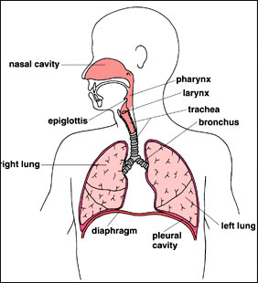
Respiratory System
What is the purpose?
To bring fresh oxygen into the body (inhale)
To get rid of carbon dioxide waste (exhale)
Part of the “excretory system”
This is a collection of body systems which all help to eliminate waste from the body

Slide 25
Respiratory System
What are the parts and their purpose?
Your respiratory system looks like an upside down tree.
Mouth/nose
Larynx: where your vocal cords can be found
Trachea: also known as the “wind pipe”, runs down your throat
Lungs: two lobes which are made up of many smaller parts; lungs are not hollow!
Diaphragm: the muscle at the bottom of your lungs which cause you to breathe; moves down and contracts to expand lungs (inhale)

Slide 26
Respiratory System
What are the parts and their purpose?
Lungs
Bronchi: two tubes which lead into the left and right side of your lungs
Bronchioles: the smaller and smaller tubes which branch off of the bronchi
Alveoli: very tiny air sacks, the end of the lungs, touching very tiny capillaries, oxygen moves from the alveoli into the capillaries, carbon dioxide moves from the capillaries into the alveoli

Slide 27
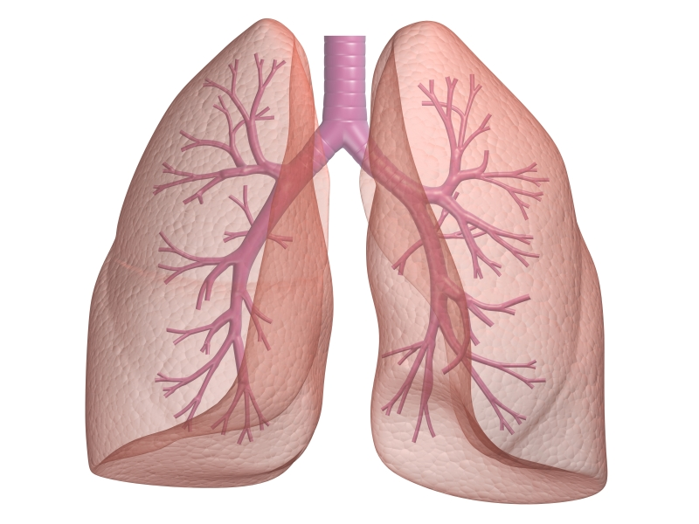
Respiratory System

Slide 28
Respiratory System
What can go wrong?
Cystic Fibrosis: a genetic condition which affects cells that produce mucus, sweat, and digestive juices; causes cells in the lungs to produce too much mucus; blocks breathing passages and traps harmful bacteria in the lungs
Asthma: bronchioles in the lungs constrict (tighten) and inflame (swell up) making breathing difficult
Emphysema: damages the alveoli in lungs making it difficult to breathe; prevents old air filled with waste from exiting the body efficiently

Slide 29
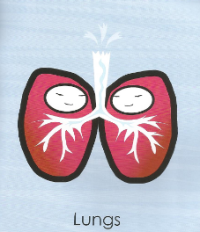
Respiratory System
A pair of gas bags that are located on both sides of your chest
Spongy lobes that suck in oxygen and breathe out waste gas
Total surface area inside is as large as a tennis court
Average capacity: 1.3 gallons
Length of lung’s airways: 1,500 miles
Resting breathing rate: 15 times per minute

Slide 30
Respiratory System
How does it work with other body systems?
Muscular system: a muscle called the diaphragm contracts and relaxes allowing lungs to pull in and push out air; provides the fresh oxygen needed for muscles to function; provides an out for waste carbon dioxide
Circulatory system: the circulatory system transports the oxygen and carbon dioxide which is inhaled and exhaled by the respiratory system

Slide 31
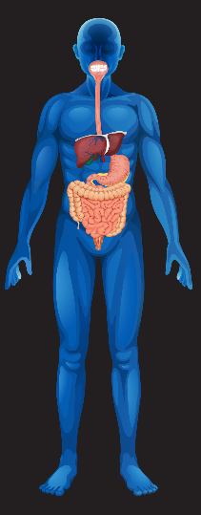
Digestive System

Slide 32
Digestive System
What is the purpose?
To break down food into its nutrients
To absorb those nutrients into the blood stream
To excrete waste from your food
Two types of digestion
Mechanical Digestion: food is mashed and physically broken down
Chemical Digestion: chemicals are added to food to chemically break them down

Slide 33
Digestive System
What are the parts and their purpose?
Mouth
Teeth mechanically grind and break down food
Saliva chemically begins to break down starches into sugars
Esophagus
Tube that pushes your food down from your mouth to your stomach
Lined with smooth muscle
Stomach
Mechanically churns and mixes up food
Stomach acid chemically breaks down food further
Lined with smooth muscle

Slide 34
Digestive System
What are the parts and their purpose?
Small Intestine
Lined with tiny finger-like structures called villi
Nutrients are absorbed through the walls of the villi and into the capillaries of the circulatory system
Large Intestine
Water is absorbed into the blood stream
Colon
Last section of intestines
Where feces wait to be excreted

Slide 35
Digestive System
What are the parts and their purpose?
Food travels through the intestines in the following order: mouth, esophagus, stomach, small intestine, large intestine, colon
There are organs that assist the digestive system which the food does not physically pass through
Pancreas: produces insulin, assists the small intestine absorb nutrients
Gall bladder: assists in the digestion of fat
Appendix: no known use in the body

Slide 36
Digestive System
What can go wrong?
Diarrhea: caused by a virus, bacteria, or indigestion; the large intestine does not properly absorb enough water causing runny stool; dehydration can result from loss of water
Lactose intolerance: the body cannot break down the sugar lactase; causes diarrhea,
Celica disease: the body cannot digest the gluten protein; causes pain and cramping in the small intestine

Slide 37
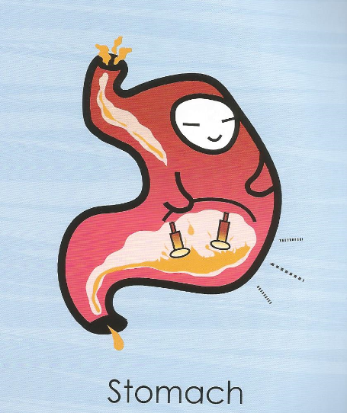
Digestive System
A rotund fellow who loves a filling meal
A well-muscled bag filled with acid and a few bacteria
An acid bath where food breaks down
Time food is in stomach: 90 min to 4.5 hrs
Stomach acid: ten times stronger than vinegar

Slide 38
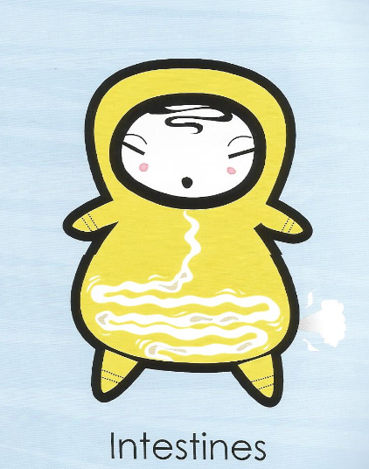
Digestive System
A long tube that snakes through your middle
Food moves through this pipe with muscular jerks and spasms
Nutrients from the food pass through the tube’s wall into the blood
Length of small intestine: 20 ft
Length of large intestine: 5 ft
Time food spends in intestines 12 hours

Slide 39
Digestive System
How does it work with other body systems?
Circulatory System: once nutrients are broken down into small pieces they are carried throughout the body in the circulatory system
Muscular System: nutrients broken down are supplied to the muscles to give them energy

Slide 40
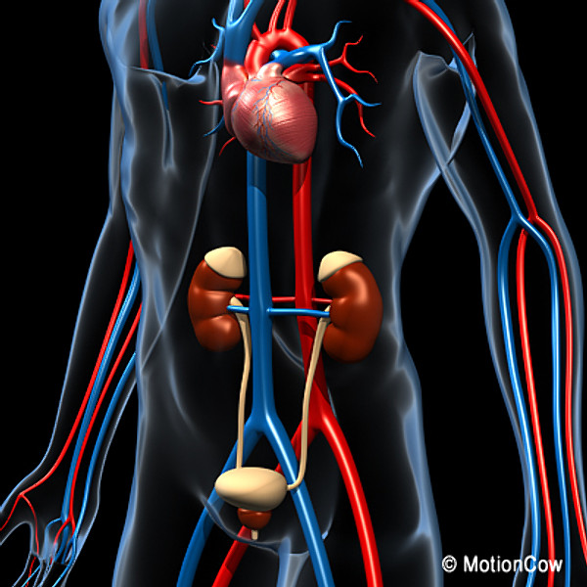
Urinary System

Slide 41
Urinary System
What is the purpose?
Filter waste and unneeded nutrients and water out of the blood
Create urine from those waste materials
Hold urine until it is ready for excretion

Slide 42
Urinary System
What are the parts and their purpose?
Kidneys: blood vessels travel through the kidneys; kidneys filter out the waste and keep the good nutrients in the blood; waste creates urine
Ureters: two thin tubes which carry urine from the kidneys to the bladder
Bladder: holds the urine until it is ready for excretion; lined with smooth muscle
Urethra: tube which the urine travels through to get from the bladder to the outside of the body

Slide 43
Urinary System
What can go wrong?
Kidney stones: calcium separates from the urine and crystallizes; can cause a round or jagged piece to become stuck in the kidney, ureters or urethra
End Stage Renal Disease: temporary or permanent damage to the kidneys that result in loss of normal kidney function; this leaves waste in the blood and can cause damaged to other organ systems in the body

Slide 44
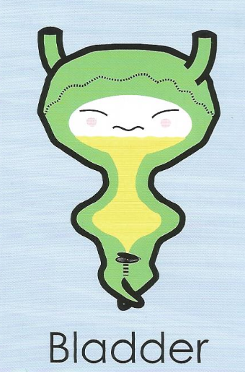
Urinary System
Holds your urine in an inflatable bag until it’s time “to go”
Urine trickles down to me from the kidneys through two tubes
When full, a valve of muscle opens to release the flow
Urine = 96% water
It’s time to go to the bathroom when your bladder is half full

Slide 45
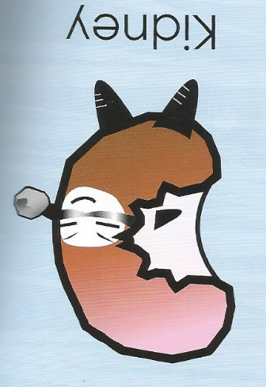
Urinary System
Filter that cleans the blood several times each day
Along with Bladder, this fellow runs your body’s waterworks
Takes excess water out of the body
Blood processed per day: 462 gallons

Slide 46
Urinary System
How does it work with other body systems?
Circulatory system: circulatory system sends blood to the kidneys so they can filter waste out of the blood stream
All organ systems: all organ systems would fail if fresh, clean blood was not supplied to them

Slide 47
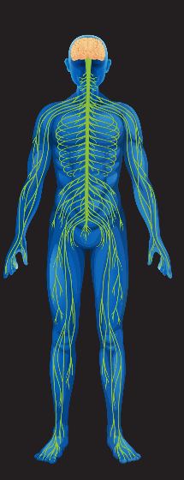
Nervous System

Slide 48
Nervous System
What is the purpose?
Interpret the outside environment
Sight, hearing, smell, taste, touch
React accordingly to the outside environment
Stimulus: a change in the environment that an organism reacts to (Ex: a loud noise)
Response: the reaction to the stimulus (Ex: you jump)

Slide 49
Nervous System
What are the parts and their purpose?
Central nervous system:
Brain: contains 100 billion nerve cells, called neurons; controls voluntary behaviors (ex: walking, thinking) and involuntary behaviors (ex: heartbeat, blood pressure, posture)
Spinal Cord: the main pathway for information from the brain to the nerves throughout the body
Peripheral nervous system:
Nerves: nerves that leave the spinal cord and reach to every part of the body

Slide 50
Nervous System
What are the parts and their purpose?
Autonomic nervous system
Sounds like “automatic”
Controls the heart, smooth muscles in the digestive tract, and glands of the endocrine system
Two main functions is to respond quickly to changes and conserve/store energy
Different functions are controlled by different structures
Cerebellum: balance and coordination
Brain Stem: heart rate and breathing
Voluntary nervous system
Controls skeletal muscles

Slide 51
Nervous System
What can go wrong?
Alzheimer’s disease: impacts mental functions, such as memory
Epilepsy: abnormal electrical discharges from brain cells cause seizures
Multiple sclerosis: the protective lining of the nerves is attacked by the immune system
Amyotrophic lateral sclerosis (ALS): nervous system damage leads to weakened muscles; also called Lou Gehrig's disease

Slide 52
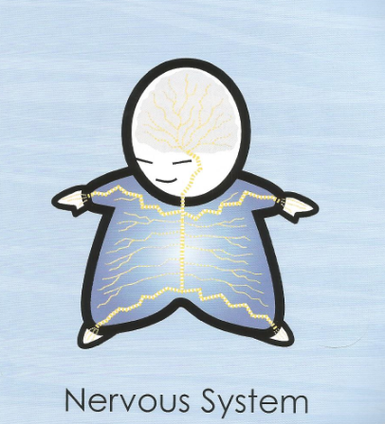
Nervous System
A sensitive guy who feels your pain
A live wire who does things without thinking
A whole-body network that reacts like greased lightning
Total length of nerves: 93,000 mi
Speed of nerve signal: 394 feet per second

Slide 53
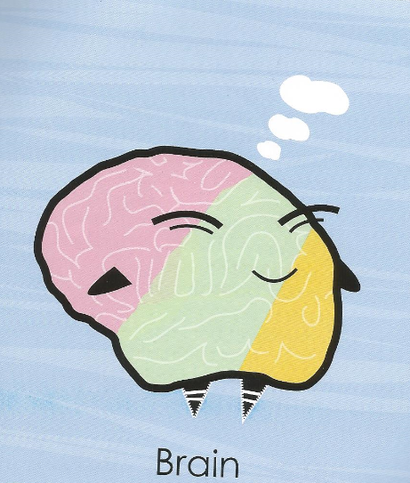
Nervous System
This clever character controls all of your body’s processes
A softy made of electrified gray matter and white matter
The location of the mind, where you do your thinking
Number of nerve cells: 100 billion
Number of nerve connections with each cell: between 10 and 10,000
Average weight: 3.1 lbs.

Slide 54
Nervous System
How does it work with other body systems?
Muscular system: voluntary nervous system controls muscle movement by sending electrical impulses through neurons
Circulatory system: autonomic nervous system controls heart rate in the brain stem
Respiratory system: autonomic nervous system controls breathing in the brain stem
Digestive system: autonomic nervous system controls movement of smooth muscle in the digestive tract

Slide 55
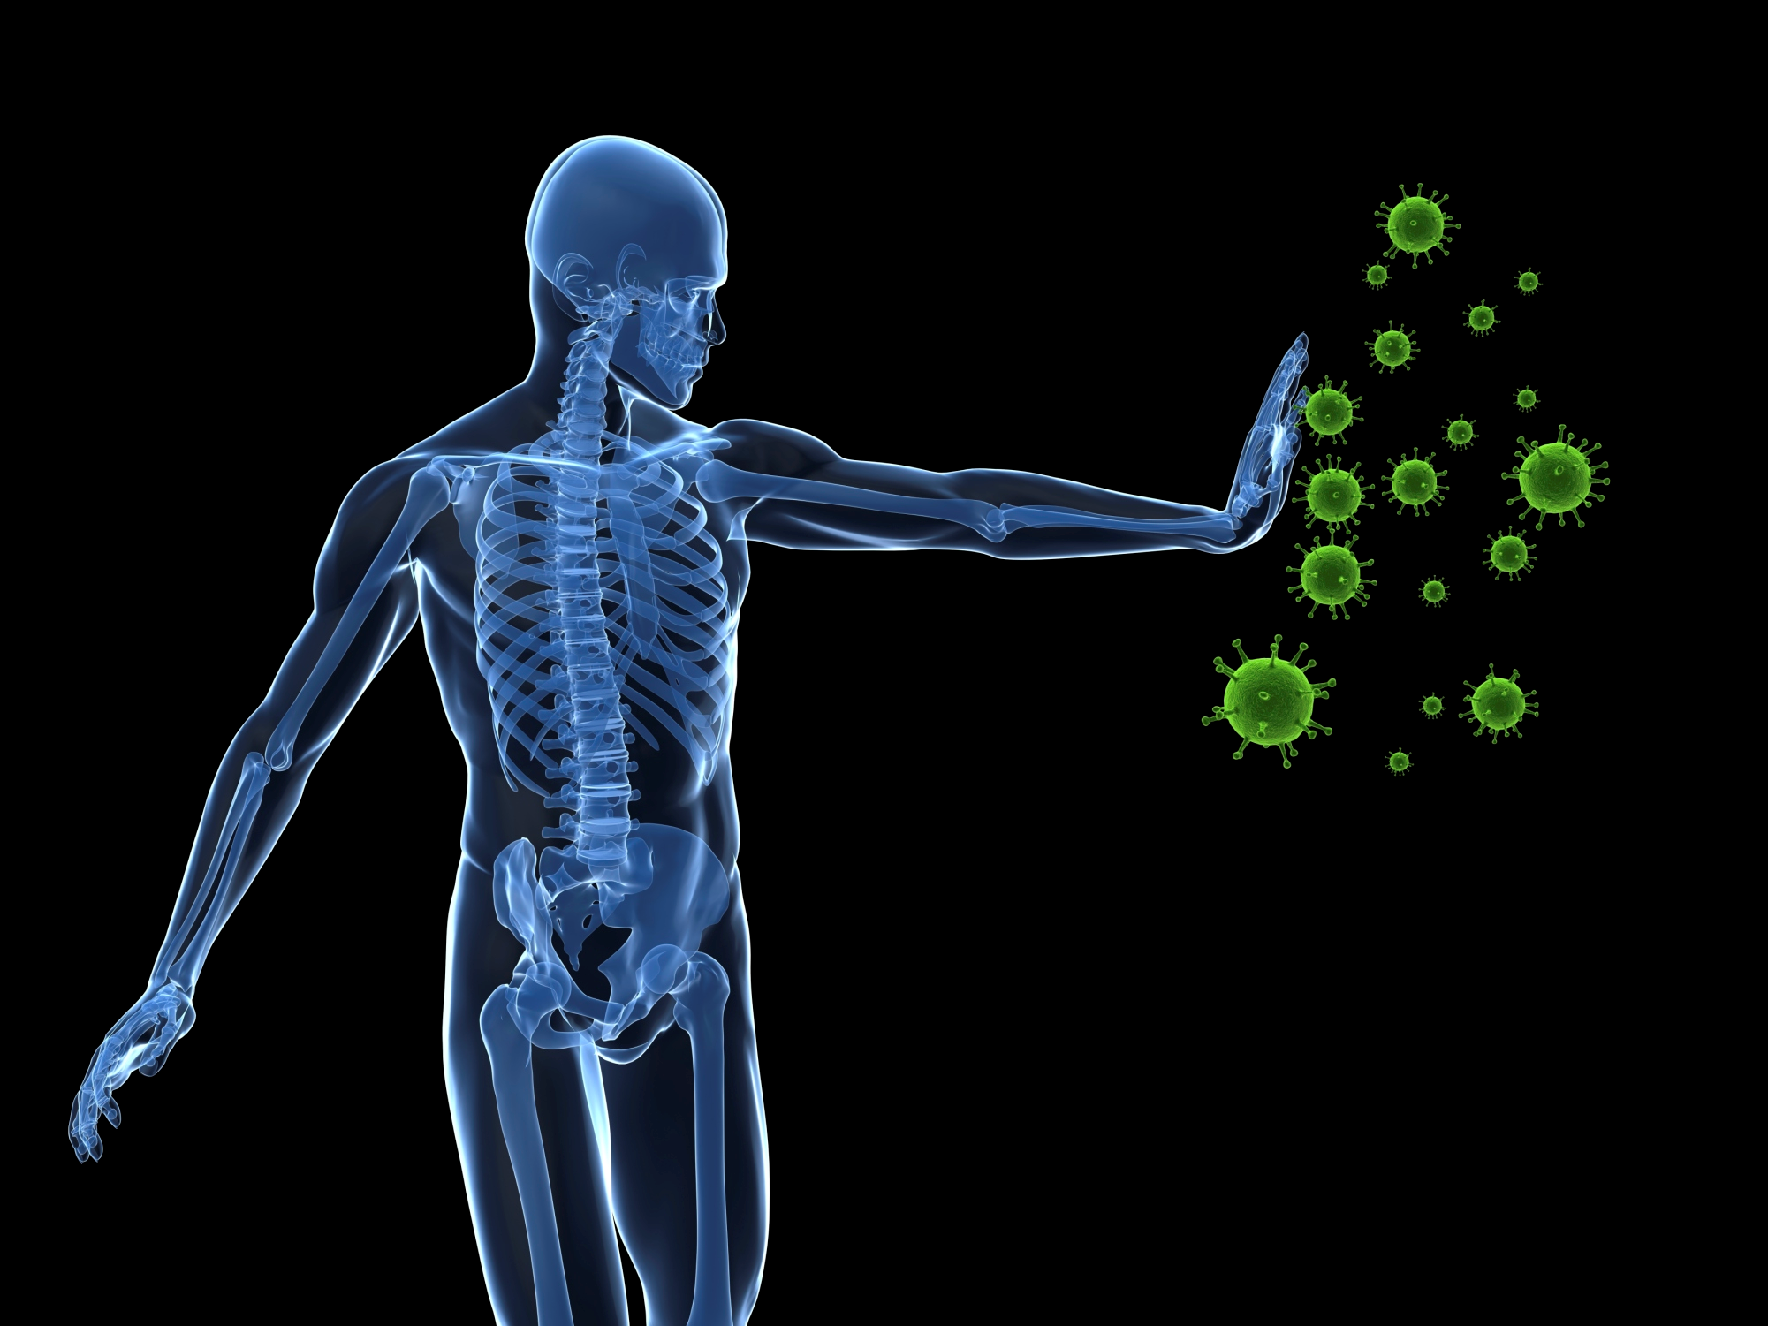
Immune System

Slide 56
Immune System
What is the purpose?
to protect against disease or other potentially harmful foreign bodies
Foreign bodies = anything that is not supposed to be in your body

Slide 57
Immune System
What are the parts and their purpose?
Lymph nodes: produce and store white blood cells
Spleen: contains white blood cells, regulates the amount of blood in the body, breaks down old blood cells
White blood cells: lymphocytes and leukocytes; attack, remember, and tag invading viruses and bacteria within the body

Slide 58
Immune System
What can go wrong?
Allergies: when the body overreacts to a foreign body, called an “allergen”
Autoimmune disorders: when the immune system works too much; attacks the organism’s own body tissues; Rheumatoid arthritis, lupus, multiple sclerosis, psoriasis
You would see an allergist or immunologist if you had any of these conditions.

Slide 59
Immune System
A white blood cell that protects you from future invasions
Patrols the blood and lymphatic systems looking for trouble
Highlights dangerous invaders with markers called antibodies

Slide 60
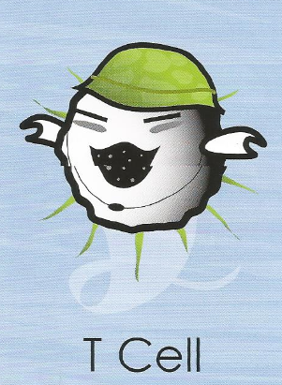
Immune System
A white blood cell that works in the immune system
A member of your body’s special forces, trained to kill invaders
Does battle in the lymphatic system and blood
Disease of the T-Cells: HIV (AIDS) attacks them

Slide 61
Immune System
How does it work with other body systems?
Skeletal system: produces white blood cells
All body systems: helps to defend all body systems from foreign bodies

Slide 62
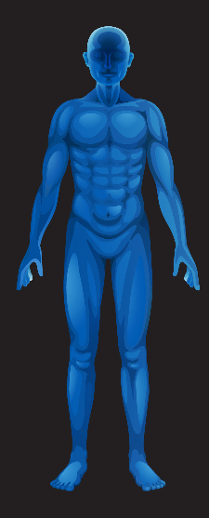
Endocrine System

Slide 63
Endocrine System
What is the purpose?
A collection of glands which produce hormones
Regulates growth and development, metabolism, tissue function, sexual function, reproduction, sleep, and mood

Slide 64
Endocrine System
What are the parts?
Hypothalamus
Pituitary
Adrenal
Thyroid
Reproductive organs
Pancreas

Slide 65
Endocrine System
What can go wrong?
Diabetes: the body does not break down glucose efficiently due to lack of insulin production
Hypothyroidism: when the thyroid under functions; causes drops in body temperature and metabolism; body functions can slow or stop

Slide 66
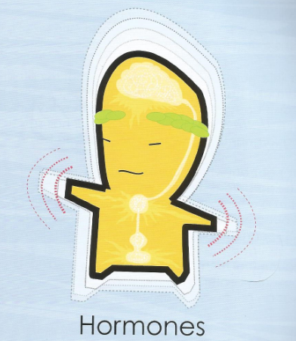
Endocrine System
Moody fellows who regulate your body’s functions
Chemical messengers that work with the nervous system
Produced by glands in several areas of the body
Number of hormones in the body: 100
Well-known hormones: insulin, adrenaline, testosterone, estrogen
Larges hormone gland: thyroid

