Slide 1
Distance vs. time
Plotting and Graphing Lesson and Lab

Slide 2
Speed
Definition: The rate of motion. (how fast motion happens)
Speed is the distance traveled in a given time.
Ball 1 moved 5 meters in 2 seconds.
(Slower speed)
Ball 2 moved 10 meters in 2 seconds.
(Faster speed)

Slide 3
Calculating Speed
Speed = Distance ÷ Time
Units: meters/seconds (m/s)
miles/hour (mph)
kilometers/hour (km/h)

Slide 4
Speed Triangles!
D
÷
S
T
x

Slide 5
Distance vs. Time graphs
Shows how speed relates to distance and time.
 | Time is on the horizontal axis (x-axis) Distance is on the vertical axis (y-axis)
Distance (meters)
Time (seconds)

Slide 6
Interpreting Distance vs. Time graphs
As an object moves, the distance it travels increases with time.
This can be seen as a climbing, or rising, line on the graph.

Slide 7
Interpreting Distance vs. Time graphs
A flat, straight line shows an interval of time where the speed is zero meters per second.

Slide 8
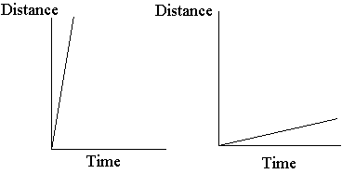
Interpreting Distance vs. Time graphs
Steeper lines show intervals where the speed is greater (faster) than intervals with less steep lines.

Slide 9
Calculating Slope
The steepness, or slope, of the line is calculated by dividing the change in distance by the change in time for that time interval.

Slide 10
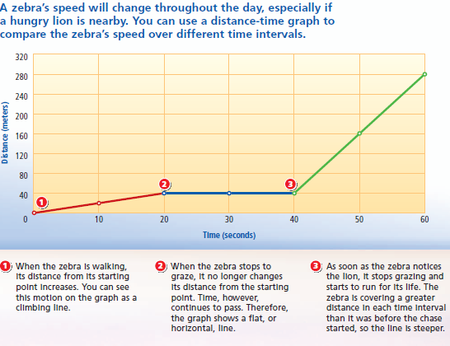
Calculating Speed from a Graph!

Slide 11
Lets Practice!
How fast is the zebra walking during the first 20 seconds?
Notes:
Walk through steps on guided notes sheets!

Slide 12
You try!
Solve the 4 practice problems on the back of your sheet!
Low volume, hard work!
Please silently raise your hand if you have any questions.

