Slide 1
Mitosis

Slide 2
When somatic cells divide
Somatic = body cells
Ex: skin cells, blood cells, bone cells, muscle cells…
Creates an exact duplicate of the original cell
One parent cell divides to become two daughter cells

Slide 3
Why? Helps your body with…
Growth
Repair
Development
Here’s how…all you have to do is remember PMAT!

Slide 4
Interphase
BEFORE mitosis
Chromosomes are copied
Cell grows and doubles its organelles
No cell division takes place in this step
First step of the cell cycle

Slide 5
Prophase
Mitosis officially begins here
Chromosomes condense so they can be seen
Nuclear membrane disappears
Spindles appear
These are the thin lines that you see stretching across the cell

Slide 6
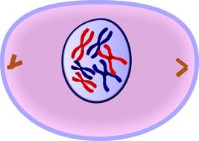
Prophase
Prophase

Slide 7
Metaphase
Chromosomes line up along the middle of the cell
Meta – think middle!
Centrosome move to opposite poles
These are the objects you see on each end of the cell, which the spindles attach to

Slide 8
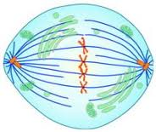
Metaphase

Slide 9
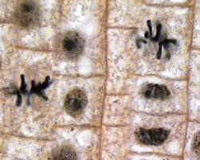
Metaphase

Slide 10
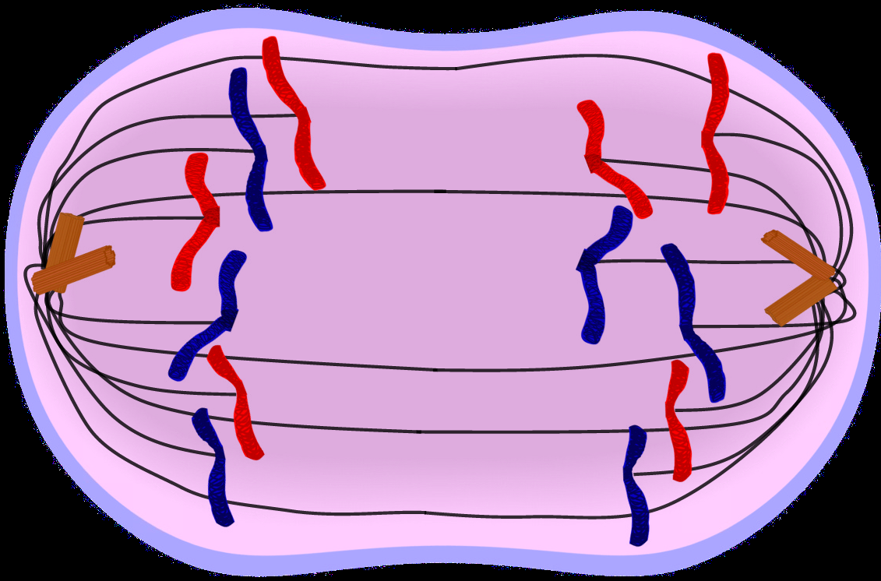
Anaphase
The chromosomes split
They move to opposite ends of the cell

Slide 11
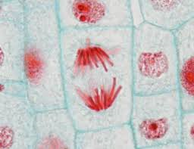
Anaphase

Slide 12
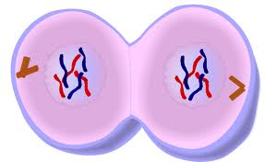
Telophase
Two new nuclei form around chromosomes
LAST step of mitosis

Slide 13
Cytokinesis
Cell membrane/wall begins to split creating two new daughter cells

