Slide 1
More energy forms
October 2014 physics

Slide 2
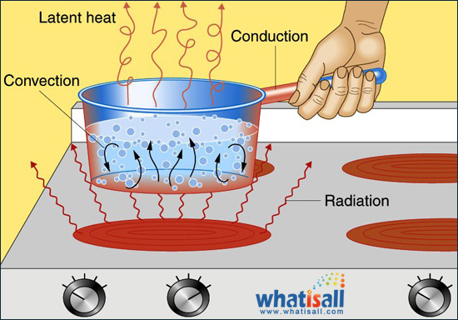
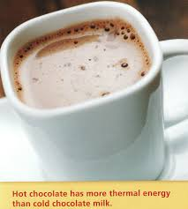
Thermal energy
Energy an object has due to the motion of its molecules.
Examples:
Sun
Hot tea
Boiling water
Toaster oven
Lightning

Slide 3
Chemical energy
Energy stored in chemical bonds.
Examples:
Batteries
Petroleum
Natural gas
Coal
Food:
(chemicals released during digestion)

Slide 4
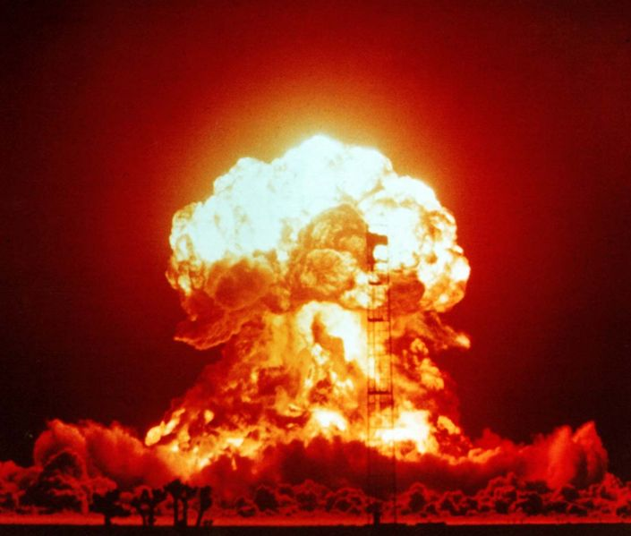
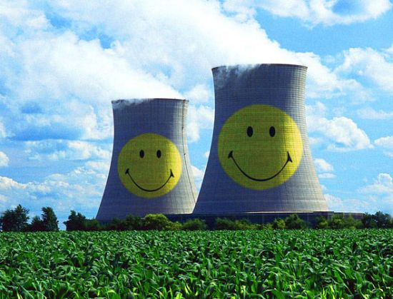
Nuclear energy
Energy stored in the nucleus of an atom.
Nuclear energy serves as an important source of power. (electrical power)
Examples:
Heat and light produced through stars
Atomic and hydrogen bombs
Nuclear weapons

Slide 5
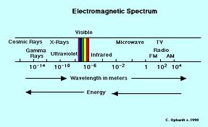
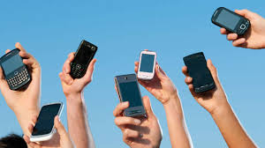
Electromagnetic energy
Energy associated with electrical and magnetic interactions.
Examples:
X-rays
Microwave ovens
Radio waves
Cell phones

Slide 6
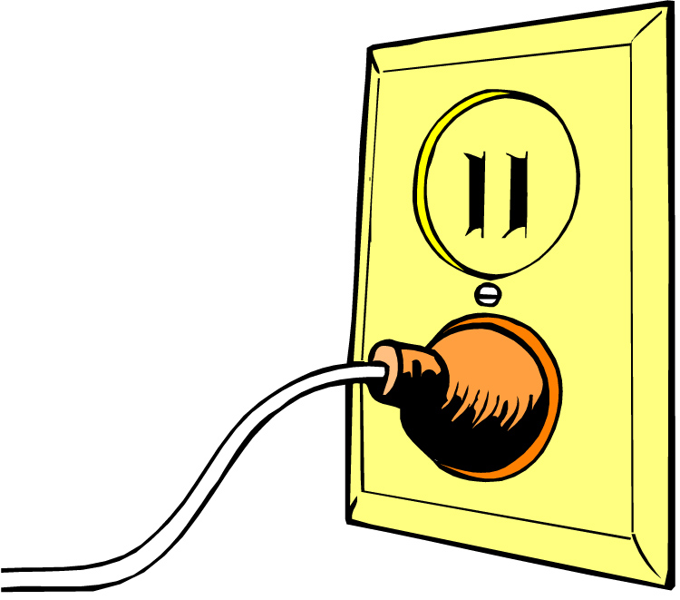
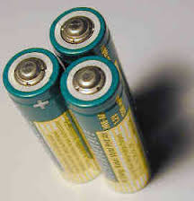
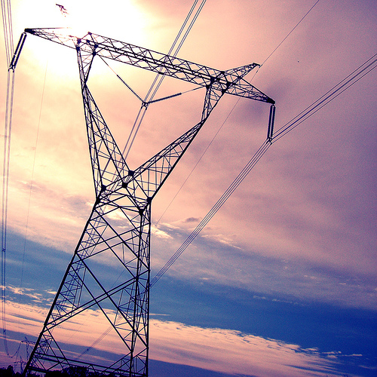
Electrical energy
Energy from the movement of electrons.
We mostly see electric energy in batteries and outlets throughout our homes.
Electrical energy lights our homes, runs motors, and makes our TV’s, refrigerators and computers work.

Slide 7
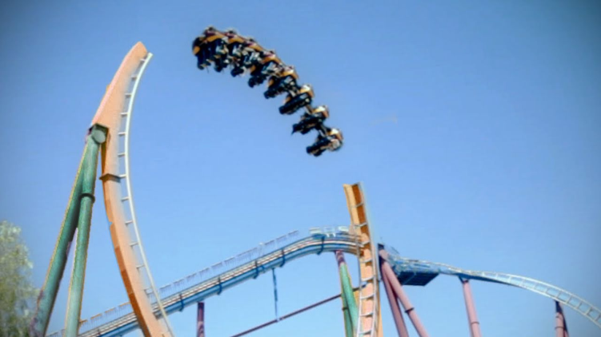
Odds
On a roller coaster, where would the most potential energy be found?
In a light bulb, electrical energy is turning into light energy.

Slide 8
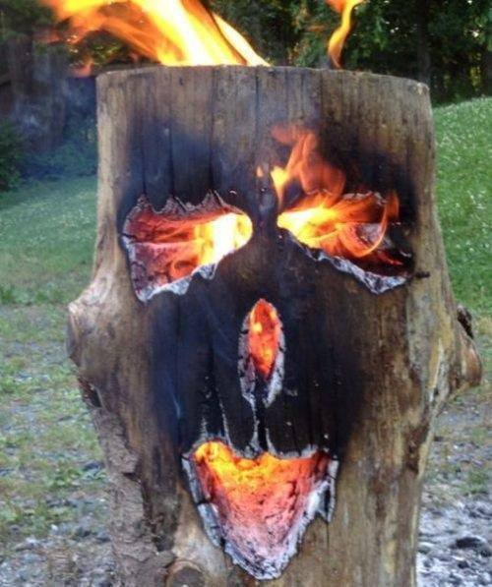
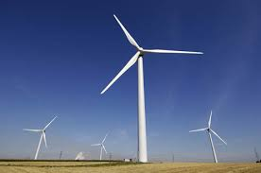
And ends
A burning log converts stored chemical energy into light and heat energy.
A windmill takes motion and converts it into electricity.
Energy in a battery is stored as chemical energy.
When your body is digesting a meal, chemical energy is being converted into movement.

