Slide 1
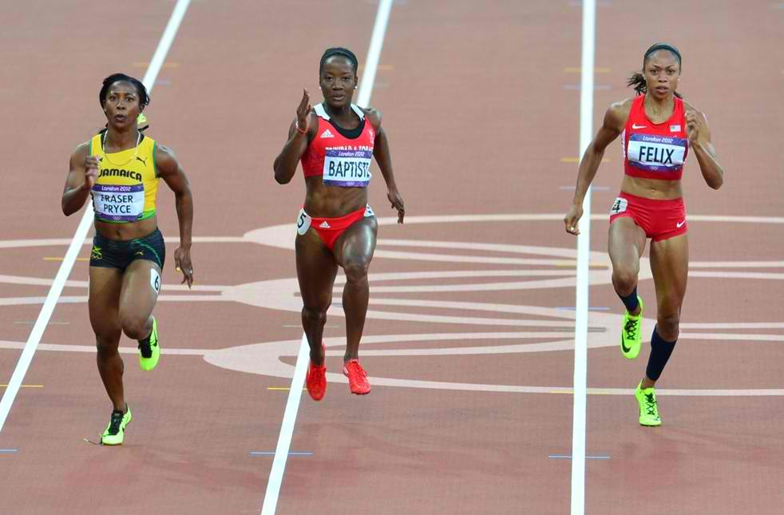
Athletics Women’s 4 x 100 meter Relay Final – USA World Record
Place: London 2012 Olympic Games
Your task: To watch with open eyes and observe what you see going on in the 4 x 100 meter final race.
Notes:
http://www.youtube.com/watch?v=iQM0btlfO1o

Slide 2
What do you think today’s lesson is about???

Slide 3
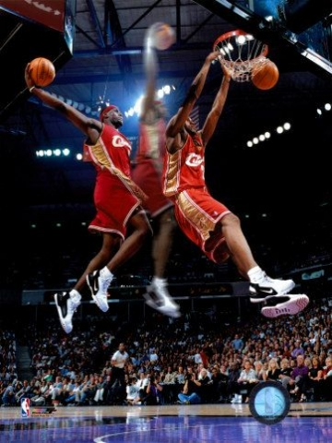
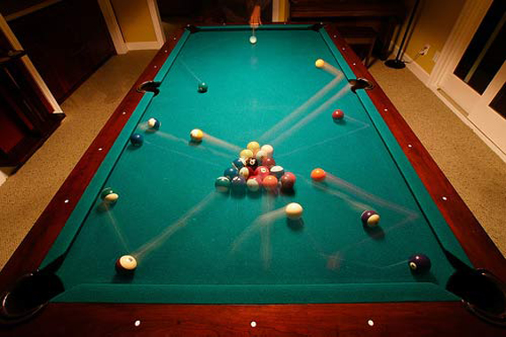
What is Motion?
Motion is the change in position over time.

Slide 4
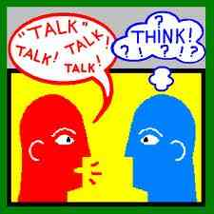
Turn and talk to your partner
Motion is the change in position over time…….
What does that mean???

Slide 5
We know what MOTION is, but what is POSITION??
What are some synonyms for position?
Notes:
List words on the board….wait for students to say the word LOCATION.

Slide 6
How do you describe the location of an object?
Choose an object in the classroom.
Without pointing to, describing, or naming the object, give directions to a classmate for finding it.
Ask your classmate to identify the object using your directions.
Go until your partner finds the object.

Slide 7
What do YOU think??
What kinds of information must you give another person when you are trying to describe a location?

Slide 8
So…what is POSITION?
The position is the location of an object or place.
Often you describe where something is by comparing it to your position or the position of another object or place.

Slide 9
Example
Vertical
Horizontal
Notes:
Teacher ask questions about the picture….1. What is happening in the picture? A: She is doing a long jump, she is in motion. 2. What is motion? A: The change in position over time. 3. What changes in positions do you see? A: Horizontal and vertical positions change.
Picture shows athlete at several positions during a long jump. If you were to watch her jump, you would see that she is in motion. Remember that motion is the change in position over time. As she jumps, both her horizontal and vertical positions change. If you missed the actual jump, you would still know that motion occurred because of the distance between her starting and ending positions. A change in position is evidence that motion happened.

Slide 10
Lets try this ourselves!
Conclusion: A change in position is evidence that motion has happened.
Notes:
Choose 1 student…have them come to the front of the room and tell them to take a good hard look at the classroom. Send this student to the hall. Instruct the class to very quickly and quietly all change seats. Have the student come back in the classroom. Ask the student what has happened? Has there been motion? How could they know without have seeing the motion themselves? Lead to the answer of a change in position (all the students have changed location, aka their seats) is evidence of motion (a change in position).
You did not see them change seats, but you still know that motion occurred because of the distance between the students starting and ending positions (their original seat to changed seat). A change in position is evidence that motion happened.

Slide 11
What is Motion??
Notes:
http://www.youtube.com/watch?v=o8feGzdsQOU

Slide 12
Motion
Motion is the change of position over time.
When describing motion, the answer depends on the position and motion of the person observing you.

Slide 13
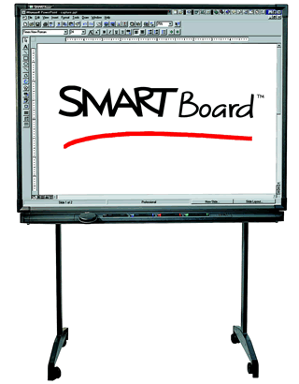
Position
Position describes where an object is.
What’s your position
to the SmartBoard?

Slide 14
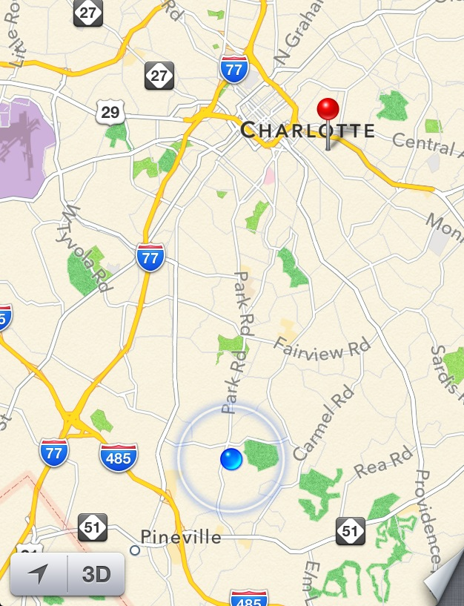
I live about 7 miles WEST of JMMS.

Slide 15
Question | Notes
1. What is a reference point? | A location (object or places position) to which you compare other locations (or positions)

Slide 16
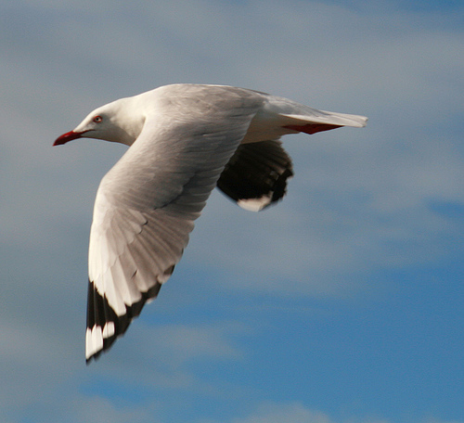
Non example: A flying bird

Slide 17
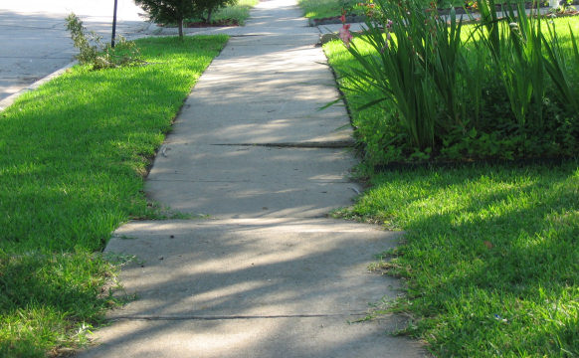
Example: A sidewalk

Slide 18
Non example: A moving bus

Slide 19
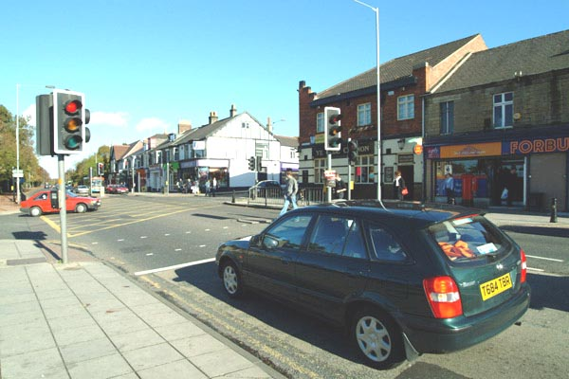
Non-example: A car at stoplight

Slide 20
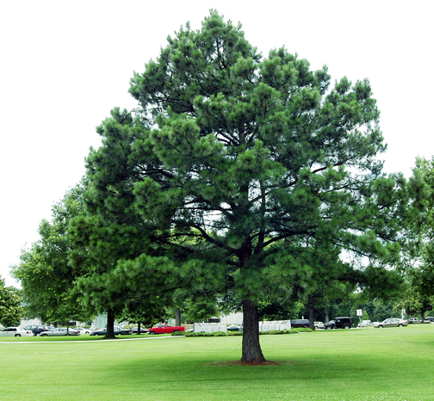
Example: A tree

Slide 21
Question | Notes
2. What characteristic do good reference points have? | They are fixed (they do not move themselves).

Slide 22
Question | Notes
3. Why are reference points important to scientists? | They help determine if an object is in motion.

Slide 23
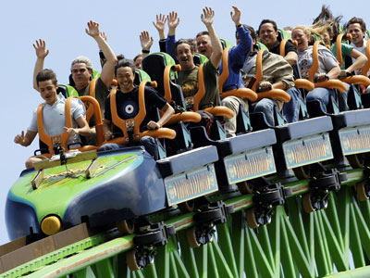
Are you or are you not moving?
http://www.youtube.com/watch?v=hZnahd7zKE4
Notes:
http://www.youtube.com/watch?v=hZnahd7zKE4 – depends on the reference point..if youre somebody on the ground then it is moving, but if you look at the person next to you still in seat

Slide 24
Is the sun actually moving?
Notes:
No --- the earth is rotating around the sun

Slide 25
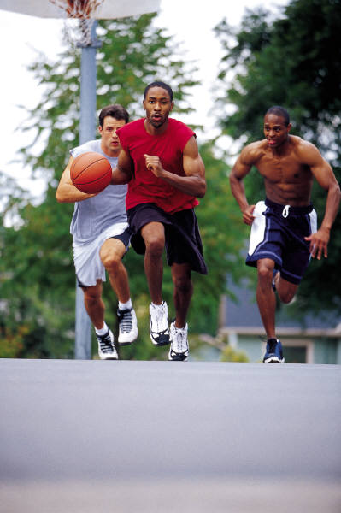
Question | Notes
4. What is a reference direction? | A direction used to describe motion.
http://www.youtube.com/watch?v=sA2zYD2A45c
Notes:
http://www.youtube.com/watch?v=sA2zYD2A45c ---- North, South, East, West, right, left, up, down, in front of, behind, etc

Slide 26
You are skate boarding 15 mph.
What is the best reference point you can use to determine your motion if you see this?
The pole on the sidewalk because it’s in a fixed position (not moving).

Slide 27
Anticipation Questions!

Slide 28
Relative Motion
Relative motion is just a way of saying that sometimes different people will say different things about the motion of the same object.
This is not because one of them is wrong, but because they are using different frames of reference.

Slide 29
Frame of Reference
Just as position is described by using a reference point, motion is described by using a frame of reference.

Slide 30
Question | Notes
5. What is a frame of reference? | You can think of a frame of reference as the location of an observer.

Slide 31
Frame of Reference
When you are standing on the ground, that is your frame of reference.
Anything that you see, watch, or measure will be compared to the reference point of the ground.
If I am standing in the back of a moving truck, the truck is now my frame of reference and everything will be measured compared to it.

Slide 32
Are you or are you not moving?
Notes:
All depends on frame of reference….if person on the ground is looking up (ground is their reference point), you (in the roller coaster) are in motion….if you are on the roller coaster and the person next to you (reference point) is not in motion because their position (their seat) is not changing

Slide 33
Example 1 – THINK, PAIR, SHARE
If you are on the bus, is the bus driver in motion??
Hint: Remember what MOTION is…

Slide 34
Example 1
If you are on the bus, the driver is not changing his position compared with the inside of the bus.
AKA…his position has not changed. He is still in his seat!

Slide 35
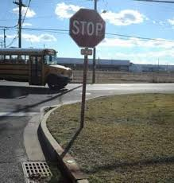
Example 2 – THINK, PAIR, SHARE
A person is on the sidewalk, and the bus passes her. Is the bus driver in motion??
What about the stop sign that she is standing next to?

Slide 36
Example 2
To the observer on the sidewalk, the driver is changing position along with the bus.
The street sign, is not changing position. From this observer’s point of view, the street sign is not moving, but the driver is.

Slide 37
QUICK REVIEW:
REFERENCE POINT- a fixed object/place that you use to describe position
FRAME OF REFERENCE- location of the observer who may or may not be moving

Slide 38
Check Your Understanding – Sit or Stand
You are driving in a car with your friends. In relation to a person standing on the sidewalk, you are (moving/not moving). In relation to the driver of the car you’re in, you are (moving/not moving).

