Slide 1
Newton’s laws
Mettler 2015

Slide 2
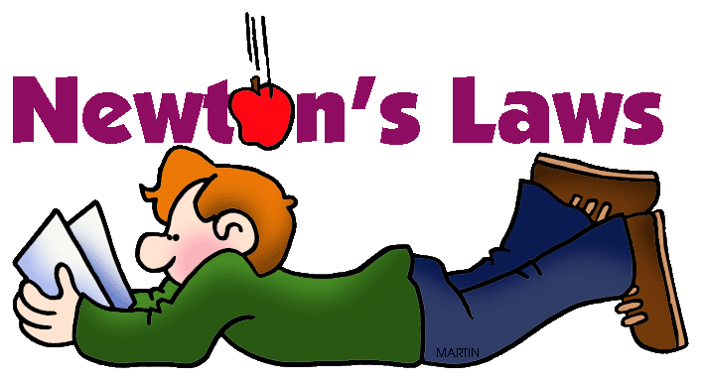
These laws explain how forces act upon objects and how it affects their motion.
Force: a push or a pull; something that changes the motion of an object
Examples:
Gravity: an invisible downward pull toward the Earth
Friction: a force that resists the motion between two surfaces in contact
Air resistance: friction due to air

Slide 3
Newton’s 1st Law of Motion
A scientific law stating that objects at rest remain at rest, and objects in motion remain in motion with same velocity, unless acted on by an unbalanced force.
Inertia: the resistance of an object to change in the speed or direction of its motion
Example: a football lying on the ground is going to stay still unless you go to pick it up. You picking up the football is called an “unbalanced force”
Unbalanced forces: forces that produce a non-zero net force, which changes an object’s motion
http://www.youtube.com/watch?v=UVdqxYyFRKY

Slide 4
Newton’s 2nd Law
A scientific law stating that the acceleration of an object increase with increased force and decreases with increased mass.
A larger force will cause an object to accelerate faster.
A heavier object needs more force to get it to move!
Let’s talk about grocery carts!!
http://www.youtube.com/watch?v=UVdqxYyFRKY

Slide 5
Newton’s 3rd Law
A scientific law stating that every time one object exerts a force on another object, the second object exerts a force that is equal in size and opposite in direction back on the first object.
http://www.youtube.com/watch?v=UVdqxYyFRKY

