Slide 1
Simple Machines
Science January 2016

Slide 2
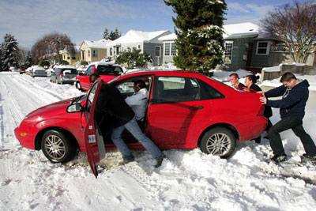
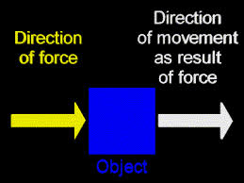
Work
Work is when a force that is applied to an object MOVES that object.

Slide 3
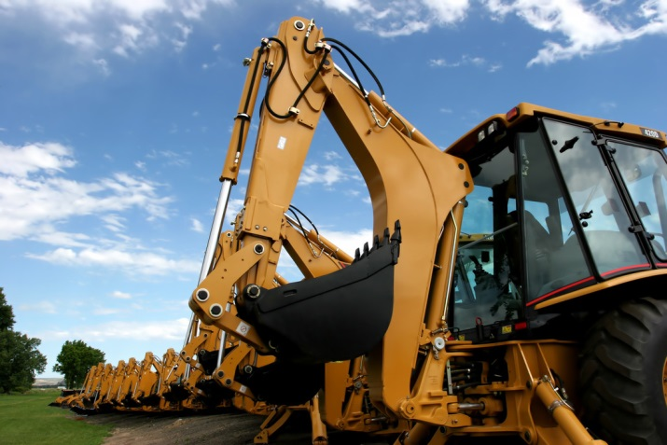
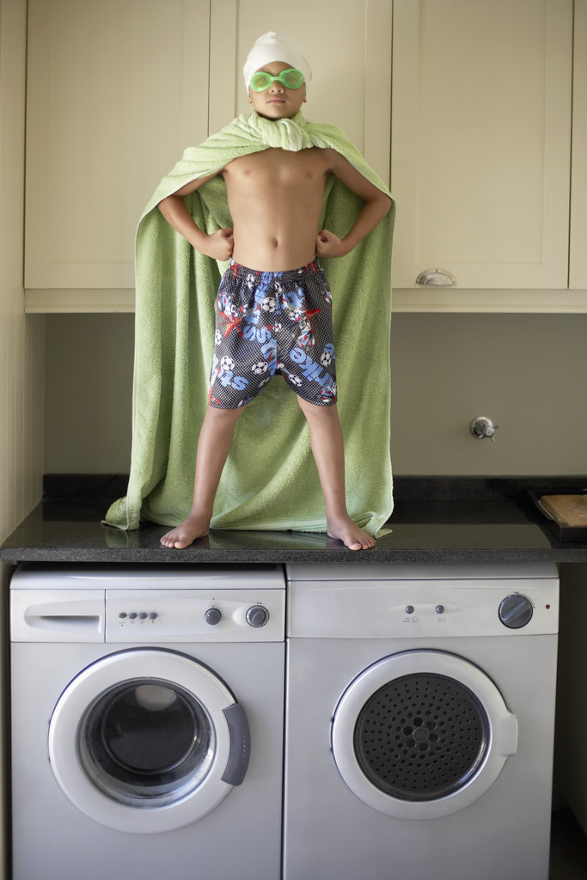
Machines
A machine is any device that helps people do work

Slide 4
Mechanical Advantage
Mechanical Advantage: the advantage that a machine gives you which makes work easier

Slide 5
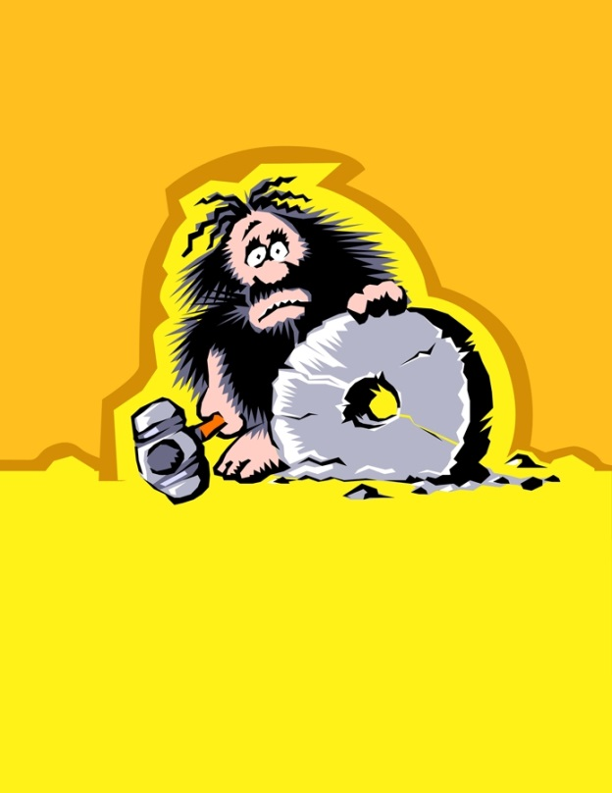
Simple Machines
Simple Machines are the six machines on which all other mechanical machines are based

Slide 6
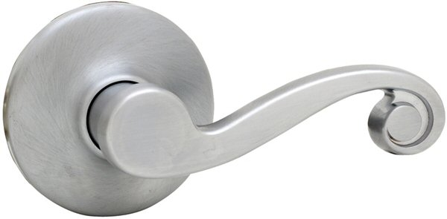
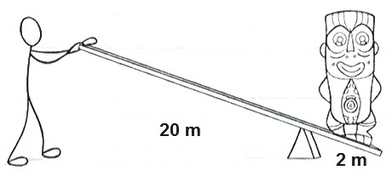
Levers
A lever is a solid bar that rotates, or turns, around a fixed point.
Fulcrum: the point on which the lever rests.
Examples: door knob, see saw, crowbar

Slide 7
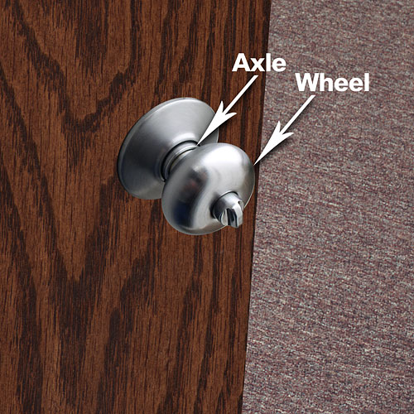
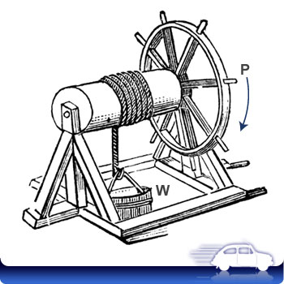
Wheel and Axle
Wheel and Axle: made of a wheel attached to a shaft.
Examples: wheels on cars , a water well, round door knobs

Slide 8
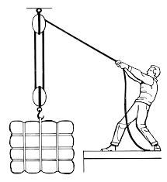
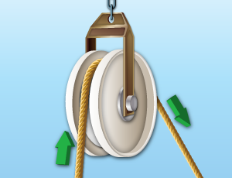
Pulley
A pulley is a wheel with a grooved rim and a rope that rides in the groove.
Pulleys redirect the force to make work easier.
Examples: elevator, flagpole, cranes

Slide 9
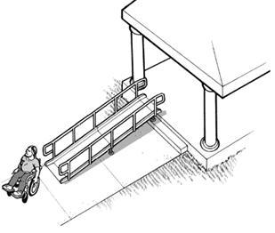
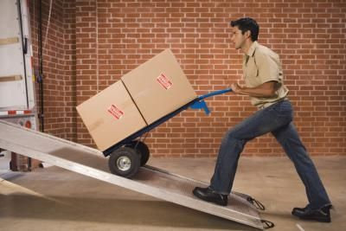
Inclined Plane
An inclined plane is a sloping surface.
Examples: handicapped ramps, moving truck ramps
To increase mechanical advantage, you increase the length of the ramp

Slide 10
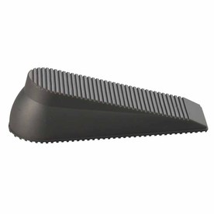
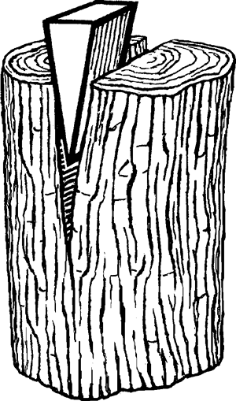
Wedge
A wedge has both a thick end and a thin end. Used to split things in two.
A roof composed of two inclined planes forms a wedge.
Examples: axe, door stop, knives

Slide 11
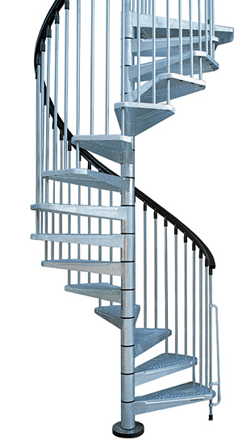
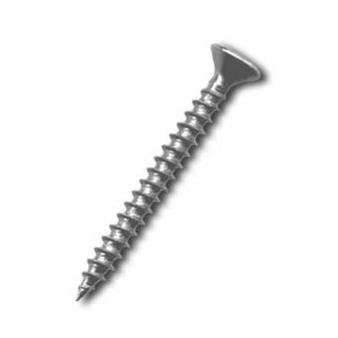
Screw
A screw is an inclined plane wrapped around a cylinder or cone to form a spiral.
Examples: spiral staircase, screws, jar lids
Purpose: can be used to attach two objects together

Slide 12
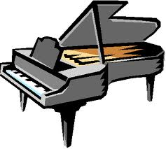
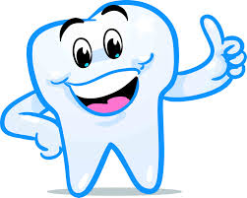
Summary
Simple machines make it easier to do work.
Our teeth act as a wedge when we bite into an apple.
A screw is just an inclined plane wrapped around a cylinder.
What machine would you use to help you lift a piano into a 4th story apartment?

