Slide 1
Speed, Velocity, and Acceleration
Mettler 2015

Slide 2
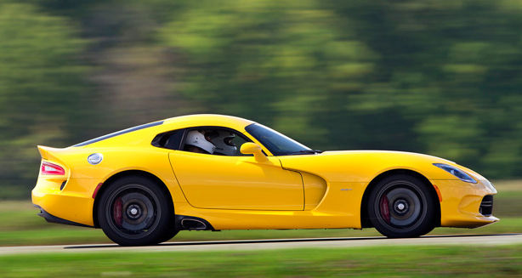
Position can change at different rates:
Speed is a measure of how fast something moves or the distance it moves, in a given amount of time
The greater the speed an object has, the faster it changes position!

Slide 3
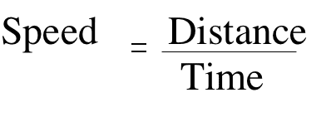
Calculating Speed
To calculate speed, you need to know both distance and time!
d= distance; S= speed; t= time
Speed can be calculated by dividing the distance an object travels by the time it takes to cover the distance
The formula is:
Speed = distance/time OR S = d/t

Slide 4
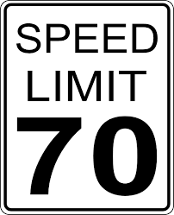
Speed Units
The standard unit for speed is m/s or meters per second
The most common speed unit we all know is miles per hour or mph

Slide 5
Let’s try a few examples:
Carlos, Lakeshia, and Mark are running in different races at JMMS. Calculate the speed of each runner. Remember, your units will be m/s for each!!
Who is the fastest runner?
Who is the slowest runner?
 | Distance | Time
Carlos | 100 m | 4 s
Lakeshia | 400 m | 8 s
Mark | 200 m | 10 s

Slide 6
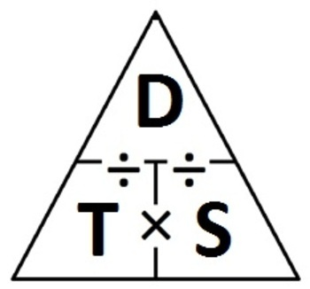
Finding distance and time
If you know any two of three variables (speed, distance or time), you can find the third- simple algebra!!
Speed = distance/time
Time = speed/distance
Distance = time X speed

Slide 7
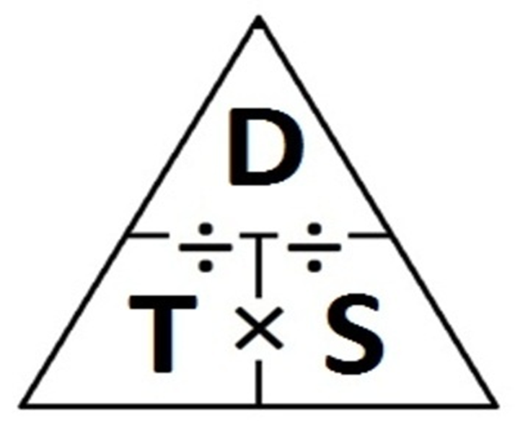
Finding Distance
Maria travels to Raleigh in 2 hours. Her average speed was 60 mph. What is the distance to Raleigh?
D=ts
D= 2 hours X 60 mph
D= ?
*** Remember to ALWAYS include units!! ***

Slide 8
Finding time
Kailee runs 10 miles at an average speed of 5 mph. How long was her run?
T= d/s
T= 10 miles/5 mph
T= ?

Slide 9
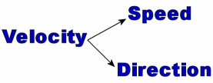
Velocity
Velocity is a speed in a specific direction.
If you say you are walking east at a speed of three meters per second, you are describing your velocity.
A person walking north with a speed of three meters per second would have the same speed as you do, but not the same velocity.

Slide 10
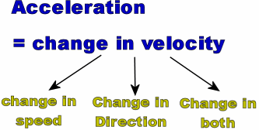
Acceleration
Acceleration is the rate at which velocity changes with time.
It is a measure of how quickly the velocity is changing; if velocity does not change, there is no acceleration.
When the acceleration is in the same direction as the object is moving, the speed of the object increases (the car speeds up)
When the acceleration is opposite to the motion, the speed of the object decreases (the car slows down). This is also called deceleration.

