Slide 1
What causes tornadoes and thunderstorms?
Ms. Mettler 2014

Slide 2
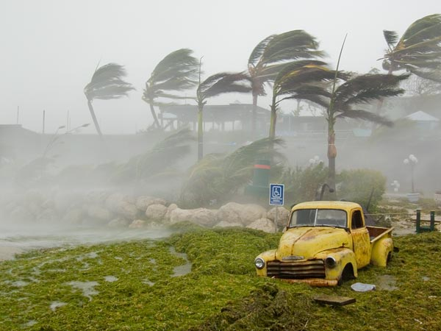
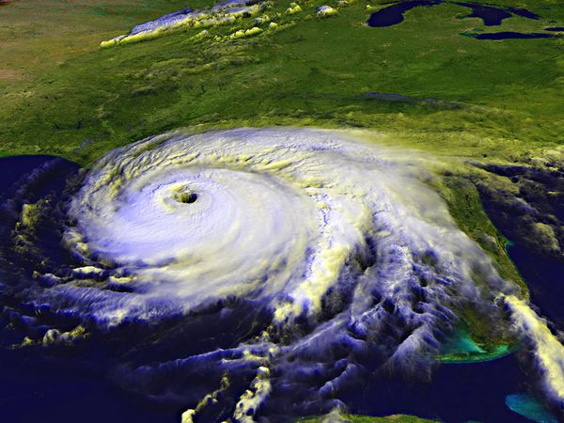
What is a hurricane?
A tropical LOW-pressure system that starts near the equator and has winds blowing at speeds of 74 mph or more.
They form over WARM ocean water.
Most often occur between August and October in the Eastern US.
Hurricanes need water and warm air to grow bigger. As soon as it moves over land or cool water, it loses its source of energy and dies out.

Slide 3
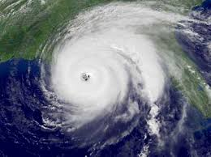
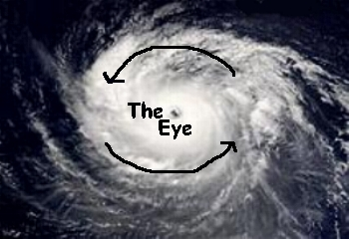
What is the eye of the storm?
The eye is the small center of a hurricane where it is clear and calm because the air is moving downward.
The eye wall is just outside the eye and the air swirls upward very quickly, forming a wall of very stormy weather.

Slide 4
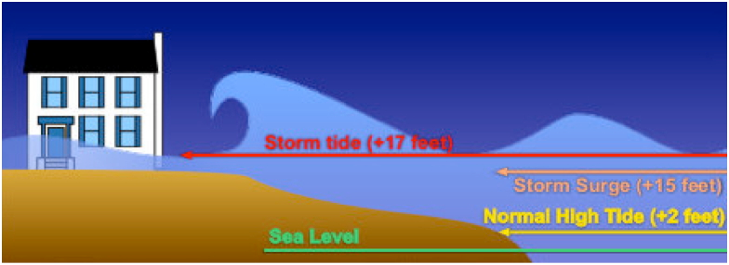
Damage due to hurricanes
Hurricane winds can lift cars, uproot trees, and tear roofs off buildings.
Heavy rains can overflow rivers and lakes, creating flooding.
Can create a storm surge: a huge mass of ocean water that is pushed onto land, flooding the coastal area.

Slide 5
Damage

Slide 6
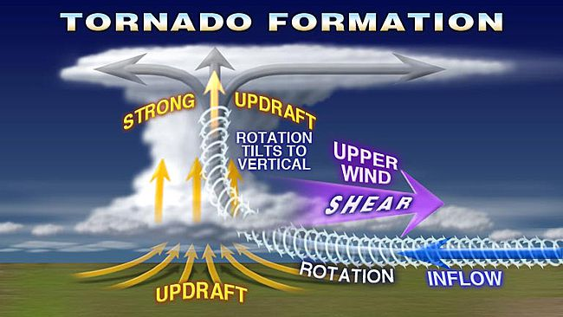
How do tornadoes form?
A tornado is a violently rotating column of air stretching from a cloud to the ground.
Tornadoes are associated with large thunderstorms that often grow to over 40,000 feet.
A column of warm humid air will begin to rise very quickly.

Slide 7
Tornado Formation

Slide 8
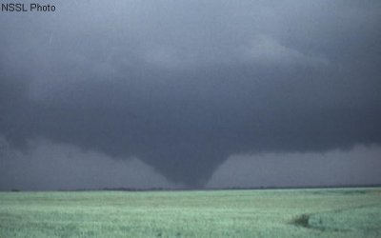
Tornado Formation
Winds at different altitudes blow at different speeds.
If the rotating air gets caught in the flow of air moving up into the storm, the spin tightens and speeds up creating a funnel cloud. Think about how a figure skater spins faster when she pulls her arms in close to her body.
The rain and hail in the thunderstorm cause the funnel to bend downward. If it touches the ground, it is a tornado.

Slide 9
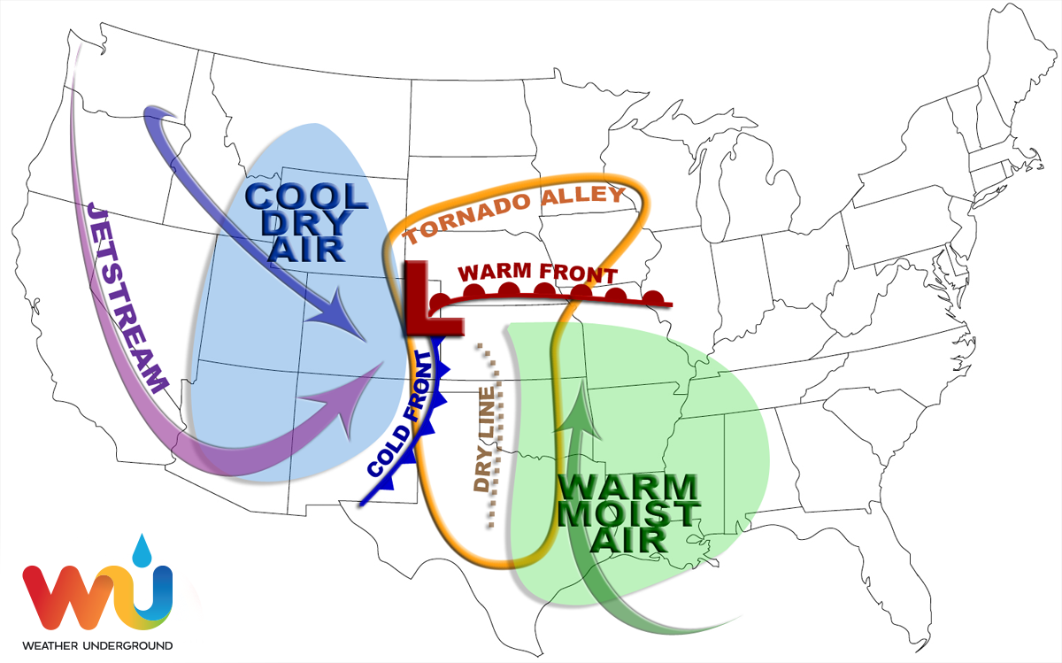
Where do tornadoes form?
Most tornadoes form in an area called tornado alley.
Cold, dry air from Canada collides with the warm, moist air from the Gulf of Mexico, causing severe thunderstorms and tornadoes..

